Slide 1



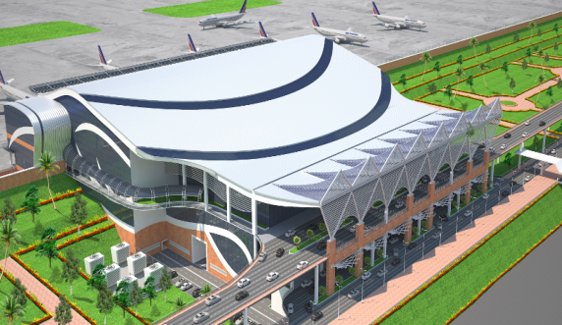

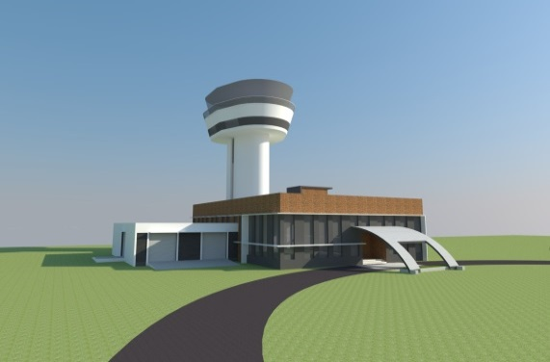
MEETING WITH MINISTRY OF CIVIL AVIATION
WINGS 2017 – 07 JULY 2017

Slide 2
Air Connectivity in Kerala
Currently, three International Airports are operational in Kerala. The fourth one (Kannur Airport ) is nearing completion.
Demand for a better connectivity to Middle East, Europe, USA, Australia, South East Asia as well as major airports in the country still prevails.
Exclusive SEZ for cargo is being considered at Kannur Airport due to land availability.
Cargo flights to International Airports may be added, due to the induced volumes. Introduction of freight carriers to Kerala will boost cargo exports/imports.

Slide 3
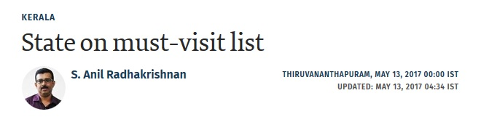



Slide 4
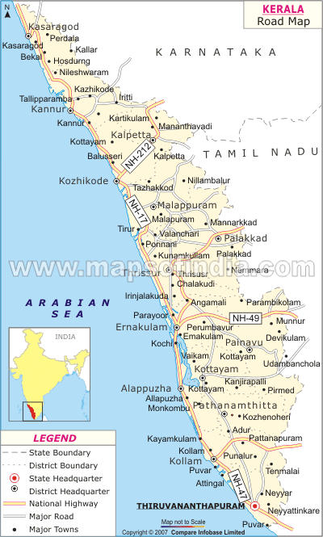
Airport Location
k
          Proposed International Airport is located in the North Malabar Region of Kerala in Kannur District.
          Airport Site is 24 Km. from Kannur and Thalassery Rly Station .
Nearest Functional Airports
Calicut Int’l Airport - 120 Km
Mysore Airport - 154Km
Mangalore Int’l Airport - 170 Km
Cochin Int’l Airport - 260 Km
Trivandrum Int’l Airport - 475 Km
k
c
t

Slide 5
Target Market
Gulf & Middle East destinations (UAE, Oman,Qatar,Bahrain,Saudi Arabia, Kuwait etc.)
SAARC (Maldives,Colombo)
South East Destinations ( Singapore, Kuala Lumpur etc.)
Domestic stations like Trivandrum,Cochin,Benguluru,Chennai,Hyderabad, Mumbai ,Delhi.

Slide 6
KANNUR INTERNATIONAL AIRPORT

Slide 7
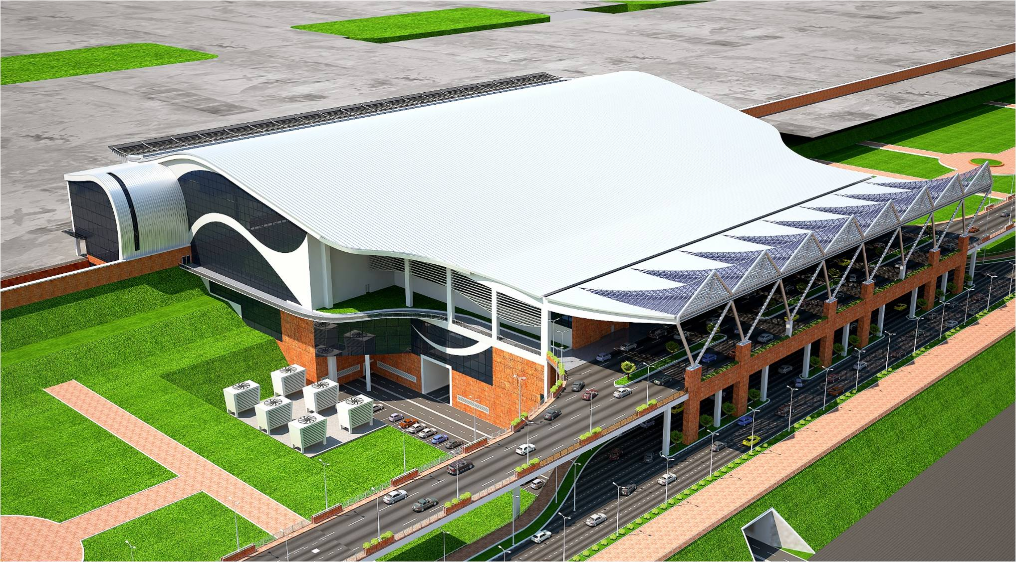
KANNUR AIRPORT – PASSENGER TERMINAL BUILDING

Slide 8
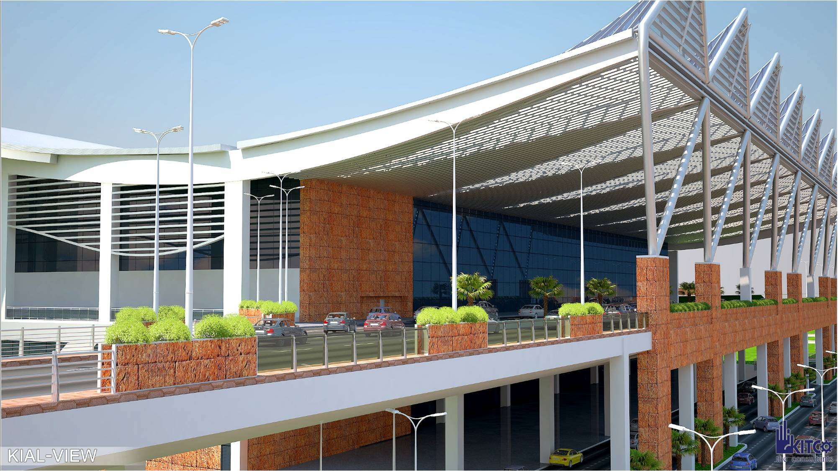
DEPARTURE CONCOURSE

Slide 9
Kannur International Airport
About the Airport
Kannur International Airport Ltd is an Unlisted Public Company promoted by Government of Kerala.
Extent of Land – 2336 acres.
Project Cost Phase I - Rs. 1892 cr ( Rs. 1000 cr as equity and Rs. 892 cr as debt).
Present runway length – 3050 m, planning to extend the runway to 4000 m in two phases.
On commissioning, Passenger Terminal Building will have an area of 96,000 sq m
Integrated Terminal Building Design with swing facility can cater to 9 million passenger per annum, with a peak hour handling capacity of 2000 pax.
Critical aircraft for the airport is Boeing 777 300 ER.
Designed to cater to Code F (A-380) aircraft in future.
Flexible Apron Sizing that can handle 20 aircraft (Code C) at a time/ 14 wide body aircraft at a time.
Apron and Terminal Building expansions in future is considered in the master plan and land reserved for the purpose.

Slide 10
B) Key features of the Airport - Aeronautical
Equipped with CAT-I Lighting
ILS facility apart from DVOR
Kannur Airport is in “Fire Category -9”.
Two Fire stations equipped with the latest fire fighting equipment.
Presence of Defence Enclave including IAF, Navy & Coast Guard
Cargo Complex to handle perishable, general cargo, etc.
Full length parallel taxi way
PTB will have six Aero Bridges
In -Line X-Ray machines in Terminal Building
State – of – the – art Standard 3 X-Ray Machines
Self –check in machines
Self Baggage Drop machines.

Slide 11
C) Key Facilities in the Airport – Non- Aeronautical
(Present)
Lounges in Terminal Building
Day Hotel with 20 rooms, along with business centre, conference facilities etc
Large area for shopping, food and beverages, Duty Free, etc.
Kannur Airport has rich green surroundings
Full Fledged Academy for Aviation and Hospitality. (Funding Aid from National Skill Development Corporation)
(Future)
Flight Kitchen.
Provision for 5 star hotels in the premises.
Airport Village and Township in the premises.
Multi- Speciality Hospital, Wellness Centre, etc.

Slide 12
FLIGHTS REQUIRED
International
GCC – Dubai
Sharjah
Abu Dhabi
Muscat
Doha
Bahrain
Dammam
Riyadh
Jeddah
Kuwait
East/ South East Asia– Singapore
Kuala lumpur
Bangkok
Hong Kong

Slide 13
FLIGHTS REQUIRED
Domestic
Trivandrum
Kochi
Bengaluru
Chennai
Hyderabad
Mumbai
New Delhi
Goa
Ahmedabad
Others
Stop – Over Options
Trivandrum/Kochi – Delhi
Trivandrum/Kochi – Bengaluru
Trivandrum/Kochi – Goa
Trivandrum/Kochi – Mumbai
Others
Regional
Mysuru
Coimbatore
Trichy
Madurai
Agatti
Arkonam
Chettinad
Neyvelli
Salem
Sulur
Thanjavur
Vellore
Puttaparthy
Pondicherry
Nasik
Mangalore
Calicut
Other Unserved/Underserved Airports in Karnataka
Tamil Nadu
Andhra Pradesh/Telangana, Maharashtra etc.

Slide 14
COCHIN INTERNATIONAL AIRPORT

Slide 15
Cochin International Airport
US/Europe direct connectivity
Cochin Airport is having full – fledged traffic potential for operating a daily flight to US/Europe .
Attractive concessions for the airlines who are ready to commence direct connectivity.
MRO in Cochin international Airport
Cochin International Aviation Services Ltd (CIASL) is setting up a world class Aircraft MRO facility.
Facilities for 2 narrow bodied aircraft can be extended by CIASL.
CIAL will be ready to extend concession on Airport charges for those utilizing the MRO facility.

Slide 16
TRIVANDRUM INTERNATIONAL AIRPORT

Slide 17
Trivandrum international Airport
Improvement of connectivity (Domestic)
Need of direct connectivity between Trivandrum and Mangalore, Madurai, Coimbatore, Ahmedabad, Goa and Pune.
Flights to Mumbai and Chennai are inadequate and frequency of flights to be increased.
Timings to be improved.
Increase Business Class capacity
B) Improvement of connectivity (International)
Introduce connectivity to Bangkok, Frankfurt, London, Melbourne and Bali.

Slide 18
CALICUT INTERNATIONAL AIRPORT

Slide 19
CALICUT INTERNATIONAL AIRPORT
Wide body aircraft need to be operated from Calicut Airport.
All efforts will be made for operationalisation

Slide 20
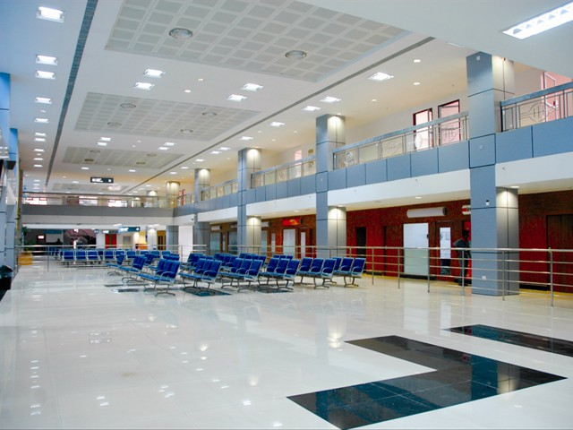

Slide 21
SABARIMALA AIRPORT

Slide 22
SABARIMALA AIRPORT
State Government plans to set up an airport near Sabarimala, one of the largest annual pilgrimages in the world.
Site selection and feasibility study are in progress.

Slide 23
Inter Airport Connectivity within Kerala
Large demand for connecting cities of Trivandrum, Kochi, Calicut and Kannur
Flights connecting the airport cities will be beneficial to the airlines.

Slide 24
Regional Connectivity
Destinations of Mysuru, Mangalore, Madurai, Coimbatore, Trichy and Goa may be connected with flights from airports in Kerala under the Regional Connectivity Scheme of GOI.

Slide 25
THANK YOU

