Slide 1

Transport (Civil Aviation) Department
Govt. Of Jharkhand
WINGS 2017
RCS Operations in Jharkhand

Slide 2
INCENTIVES TO AIRLINES
For RCS the Govt. Of Jharkhand intends to enable Air Operations on unserved routes of Jharkhand state under UDDAN scheme like:-
  1. JAMSHEDPUR
  2. BOKARO
  3. DUMKA
  4. DALTONGANJ
  5. HAZARIBAG
  6. GIRIDIH
  7. DHANBAD

Slide 3
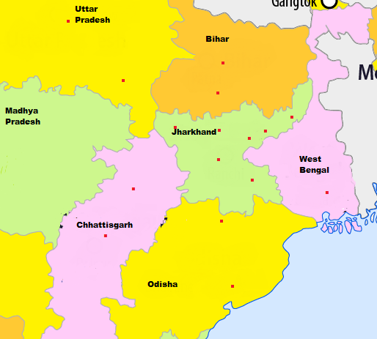
Lucknow
Patna
Varanasi
Gaya
Dumka
Daltonganj
Hazaribagh
Dhanbad
Bokaro
Ranchi
Bilaspur
Jamshedpur
Kolkata
Barbil
Raipur
Bhubaneshwar

Slide 4
State Government is committed to reduce VAT to 1% on ATF at all RCS airports for RCS flights within the state for a period of ten (10) years.
State Government shall provide land, if required, free of cost and free from all incumbencies for development and expansion of RCS airports and shall also provide multi model hinterland connectivity as required.
State Government shall provide Electricity, Water and other utility services at substantially concessional rates (approx. 50%) at RCS airports .

Slide 5
State Government shall provide Security and fire services free of cost at RCS airports.
Any other activities required for implementation of the scheme as directed by MOCA, Govt. of India form time to time.
Govt would consider any other valuable suggestions from the bidders.

Slide 6
ROUTE WISE BENEFITS
Heavy passenger load expected between Bokaro and Kolkata and onwards connections to Bihar, Orissa etc.
Bokaro Steel Limited has approx 40,000 employees.
Other routes can also get heavy traffic.

Slide 7
JAMSHEDPUR
MOU under RCS for this airport has been signed. This is a licenced airport and fulfils all necessary requirements for RCS operation. However additional fire fighting personnel and security personnel are nominated by the State Government for RCS operations. Their training shall be completed very shortly by AAI and BCAS.
Name of Airport | Sonari Airport , Jamshedpur
Runway length | 3921 Fts. (R/W-08) 4350 Fts. (R/W-26)
Owner/Operator | Tata Steel, Jamshedpur

Slide 8
BOKARO
Bokaro is known as Steel City and SAIL, Bokaro is having 40,000 (approx) employees and almost 30% employees are entitled to travel by air.
It is an ideal place for successful operations under RCS with maximum load capacity.
Name of Airport | Bokaro Airport
Runway length | 5314 Ft
Owner/Operator | Steel Authority of India (SAIL)
Expansion Plan | The runway length and airport infrastructure can be further extended up to 7000 Ft

Slide 9
DUMKA
It is second capital of the state and known as gateway of SANTHAL PARAGNA. This airport is having newly re-carpeted runway and equipped with Hangar (60ft X 80 ft), an Administrative building (35m X 55m) and second building (25m X 55m) which can be converted to Terminal building/ Passenger Lounge/ VIP Lounge/ guard rest room. The feasibility report from AAI reveals that this airport can be used for VFR operation of CAT 1B Type aircraft e.g. M28, Dornier 228, Beech Craft B-200 etc.

Slide 10
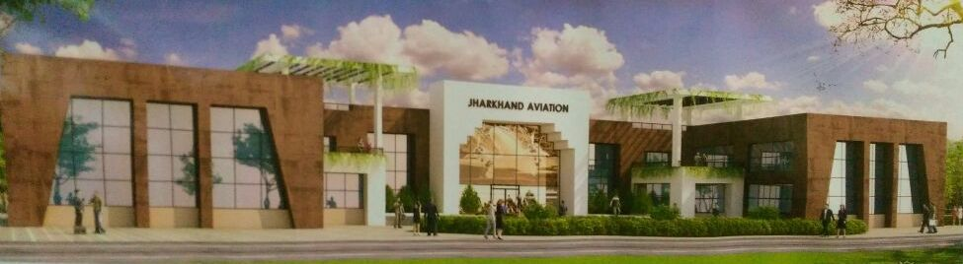
The runway can also be extended for VFR operation CAT 2C & CAT 3C if operators wish so for the operation of ATR42/ ATR72 aircraft as enough land space is available. Govt. is committed to provide additional land if required.

Slide 11
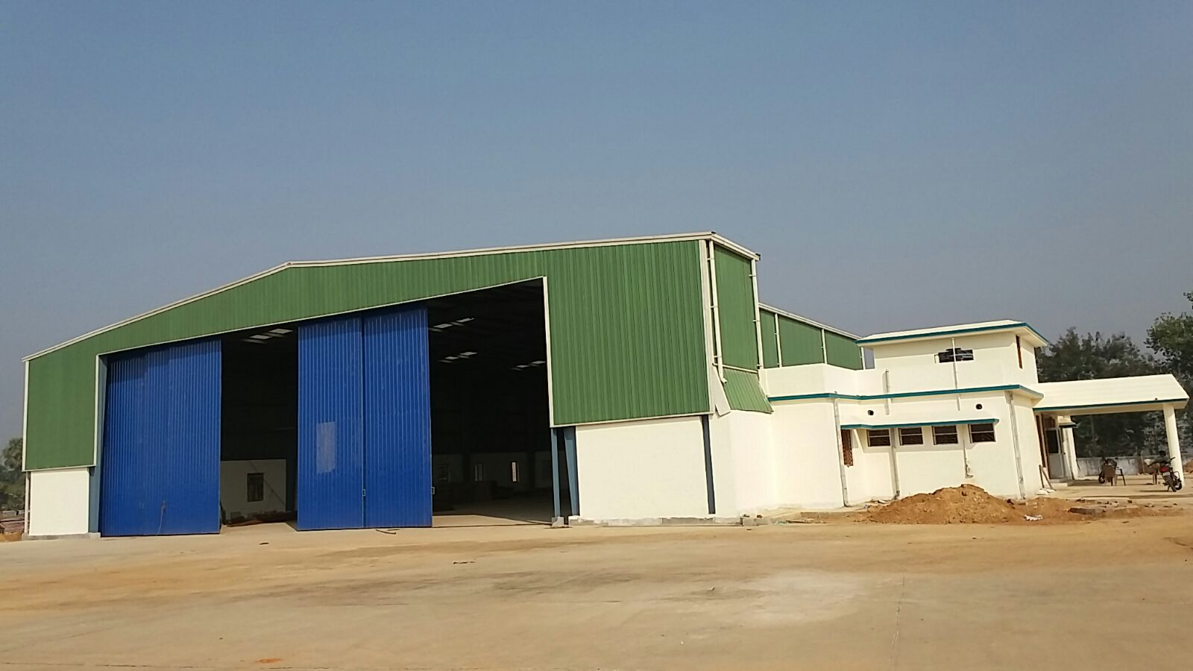
Name of Airport | Dumka Airport
Runway length | 4000 Fts
Owner/Operator | Govt. of Jharkhand

Slide 12
DALTONGANJ
It is situtated very close to state of Uttar Pradesh, Chhatisgarh, Madhaya Pradesh and Bihar. Operating from this place to Ranchi, Patna, Varanasi will make it useful under RCS operations.
Presently this airport is operational and having runway of 2916 Ft. The land is available for further extension for which the Govt. is in process of land acquisition to extend the runway up to 5400 Ft.
AAI has conducted a feasibility survey which report is awaited.
Name of Airport | Chiyanki Airport, Daltonganj
Runway length | 2916 Ft
Owner/Operator | Govt. of Jharkhand
Expansion Plan | The Runway length can be extended up to 5400 Fts

Slide 13
HAZARIBAG
It is located at a very strategic location which is very close to upcoming various industrial projects at BARAHI, very close to open wild life sanctuary and is situated at NH 33. The famous coal mines i.e. KUJJU, GOMIO, RAMGARH, TENUGHAT are run by Coal India Ltd., Tata Steel and various other navratna companies. It is close to KODERMA and TILAIYA valley, a tourist place, which is having enough potential for air travelers to Kolkata, Patna and Ranchi.

Slide 14
The state government is fully committed to develop this airport on all priority basis under RCS airport ASAP.
Presently runway length is 2422 Ft which is being extended up to 6000 Ft by State Govt. and land acquisition is in process for its further extension up to 9000 Ft.
Name of Airport | Hazaribag Airport
Runway length | 2422 Ft
Owner/Operator | Govt. of Jharkhand
Expansion Plan | Runway length extendable up to 9000 Ft, however first phase extension plan is up to 6000 Ft

Slide 15
GIRIDIH
It is located at very famous places e.g. MADHUVAN, PARASNATH, which are world famous pilgrims destination for Jain pilgrims and have crowd through out the year which will make RCS operations successful by connecting Ranchi, Gaya, Patna & Kolkata.
Presently runway length is 2996 Ft and the Govt. is acquiring the land to extend its length up to 6000 Ft.
Name of Airport | Giridih Airport
Runway length | 2996 Ft
Owner/Operator | Govt. of Jharkhand
Expansion Plan | Runway is extendable up to 6000 ft.

Slide 16
DHANBAD
It is a very famous Coal City of the state and having ample potential for air travelers.
The feasibility report from AAI reveals that this airport can be used for VFR operation of CAT 1B Type aircraft e.g. M28, Dornier 228, Beech Craft B-200 etc.
Name of Airport | Barwadda Airport
Runway length | 3700 Ft
Owner/Operator | Govt. of Jharkhand

Slide 17
The Transport (Civil Aviation) Department, Govt. of Jharkhand, welcomes all bidders for the State of Jharkhand to participate for RCS routes of Jharkhand
THANKS

