Slide 1

CIVIL AVIATION IN WEST BENGAL
- OPPORTUNITIES AHEAD
Presented
by
Transport Department
Government of West Bengal

Slide 2


Slide 3
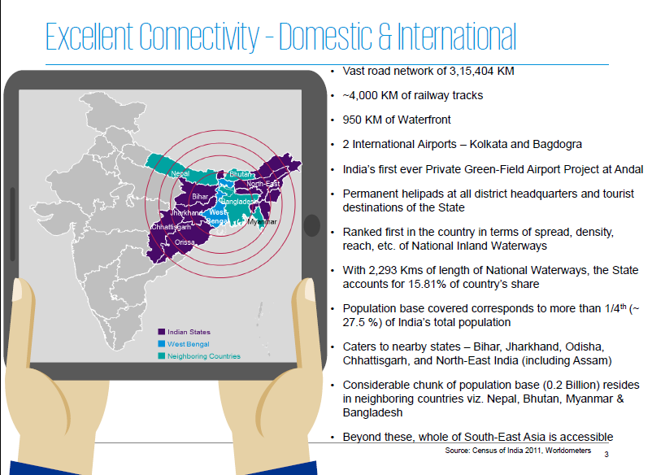

Slide 4
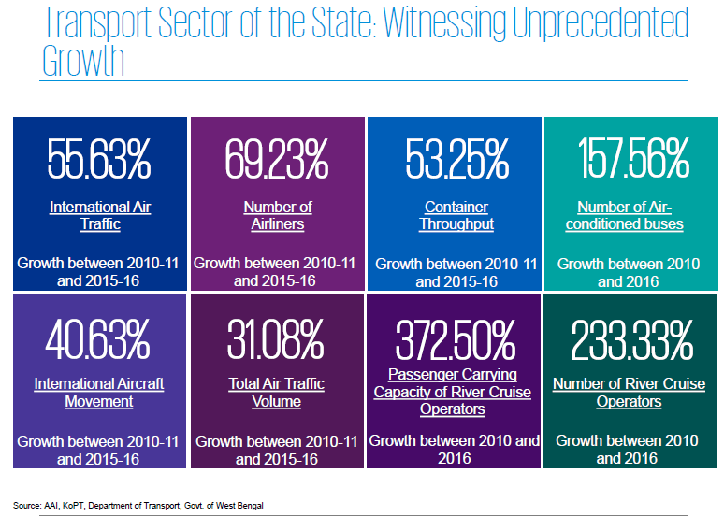

Slide 5
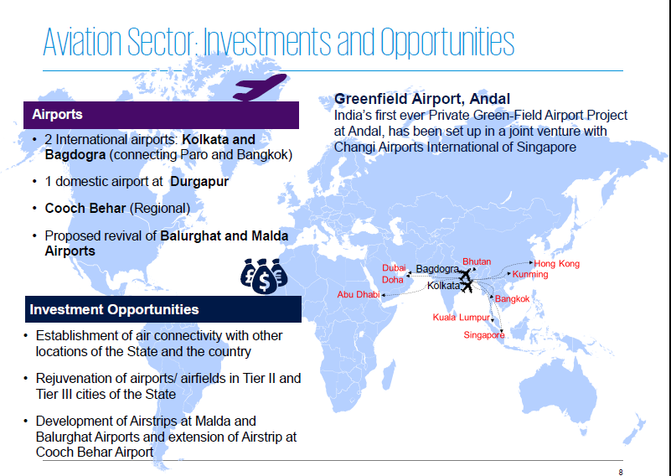

Slide 6
New Initiatives and Policies in Aviation Sector
Rejuvenation of Services for Tier-II and Tier-III cities in line with new National Civil Aviation Policy.
Complete waiver of VAT on ATF for Bagdogra , Andal and Coochbihar Airports by the State Government.
Major investment of the State Government for expansion of Runway at Coochbihar Airport.
State Government assistance at Bagdogra Airport for upgradation of infrastructural facilities including installation of Night Landing Facilities.
Rejuvenation of Runway and other facilities at Balurghat Airport for its revival.
Initiative of the State Government for development of Runway and other facilities at Malda Airport
State Government may also consider additional support to the operators in the form of seat guarantee for a few seats for air connectivity with Balurghat and Malda airports.

Slide 7
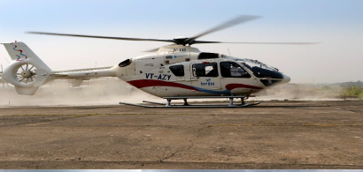
Helicopter Services : New Opportunities
26 Permanent Helipads are ready at District Headquarters and other important tourist destinations for Helicopter Services.
At present weekly Helicopter Service is continuing with one State Government Helicopter for Gangasagar, Digha etc. which has immense popularity.
State is ready to provide required support to helicopter operators for those permanent helipad locations.

Slide 8
THANK YOU

