Slide 1
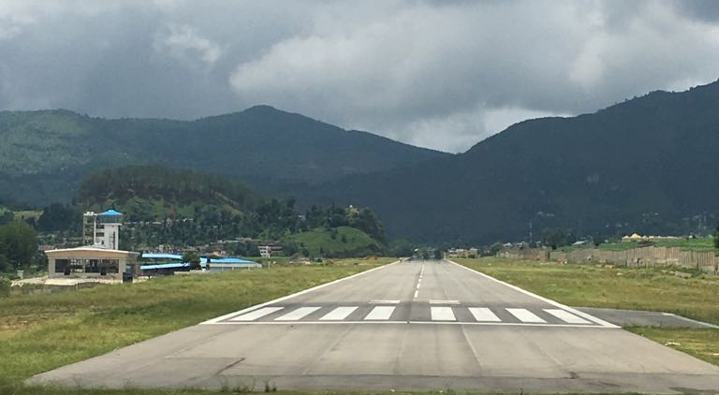
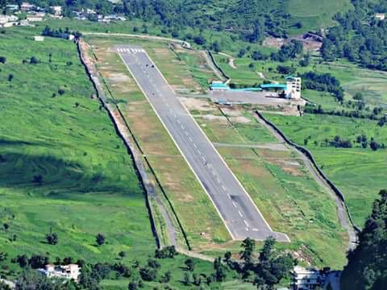
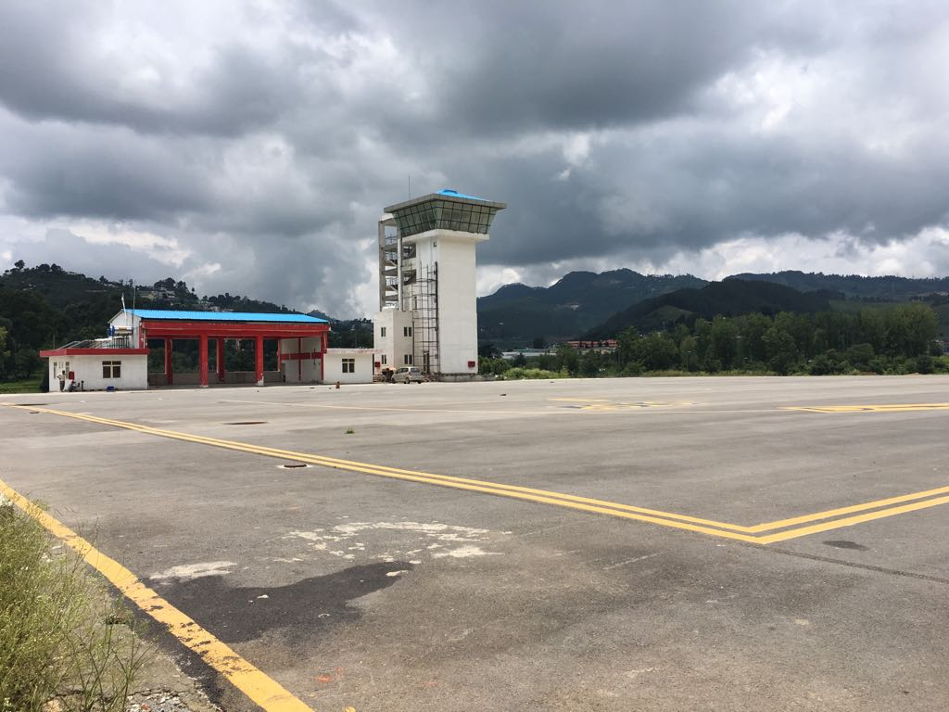
TIMELESS PITHORAGARH
Elevation: 4799’
Runway length :5300’ (R/W 14/32)
Runway width: 100’
ATC Tower: Available
Apron: Parking for 2 ATR’s
Fire fighting: Available
Passenger lounge: Available

Slide 2
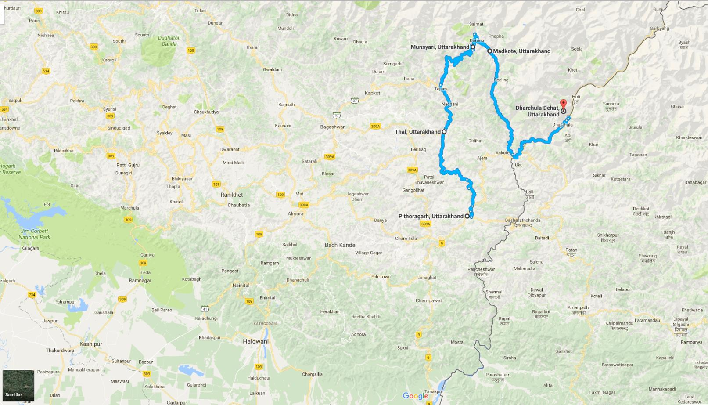
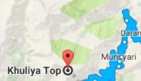
TIMELESS PITHORAGARH :
Understanding the distances
Bageshwar 132Km / 4.25 Hrs
Almora 115Km / 3.36 Hrs
PITHORAGARH
Nainital 170Km / 5.15 Hrs
Champawat 73 Km / 2.20 Hrs
Haldwani 182Km / 5.42 Hrs
Haldwani is 275 Km /5.5 hrs from Delhi

Slide 3
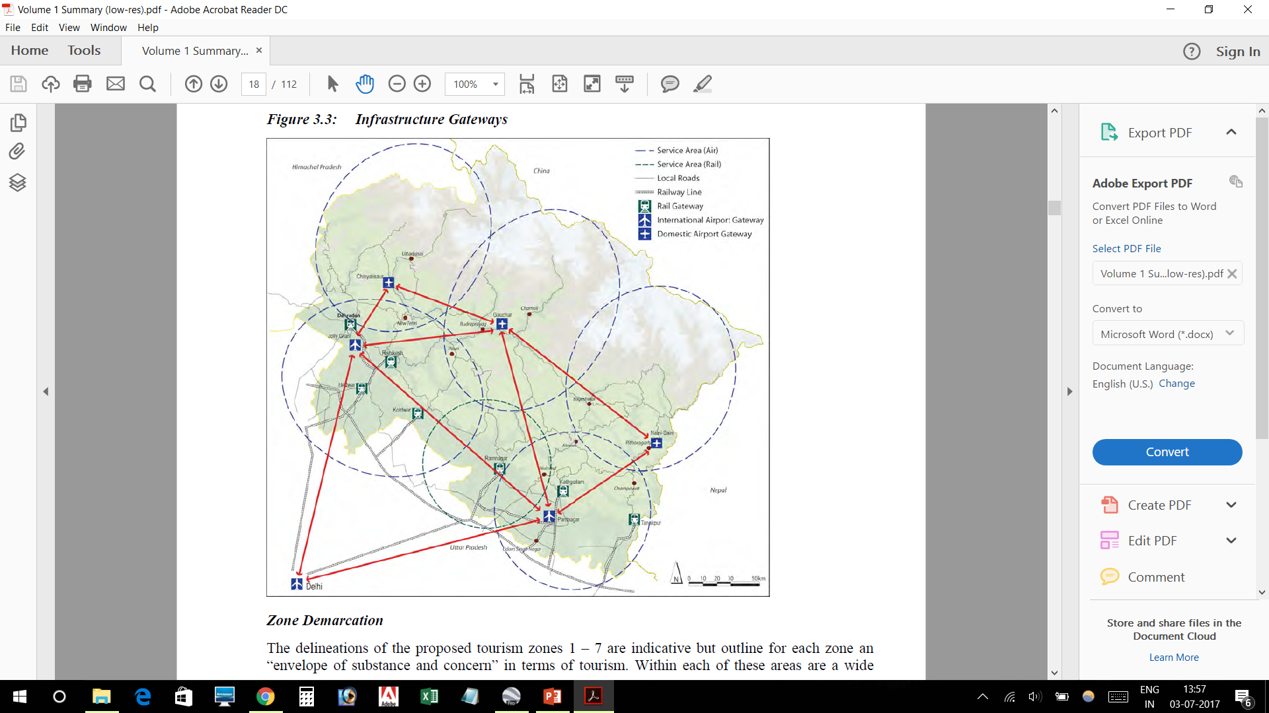
TIMELESS PITHORAGARH :
Understanding the distances
548804
487814
6045
5338
6750

Slide 4
TIMELESS PITHORAGARH :
Incentives provided by Govt of Uttarakhand
VAT on fuel reduced to 1%
20% VGF for seats under RCS
No landing/parking charges
Elect/water at concessional rates
No charges for security provided by Uttarakhand police
Class I officers authorised to travel on duty

Slide 5
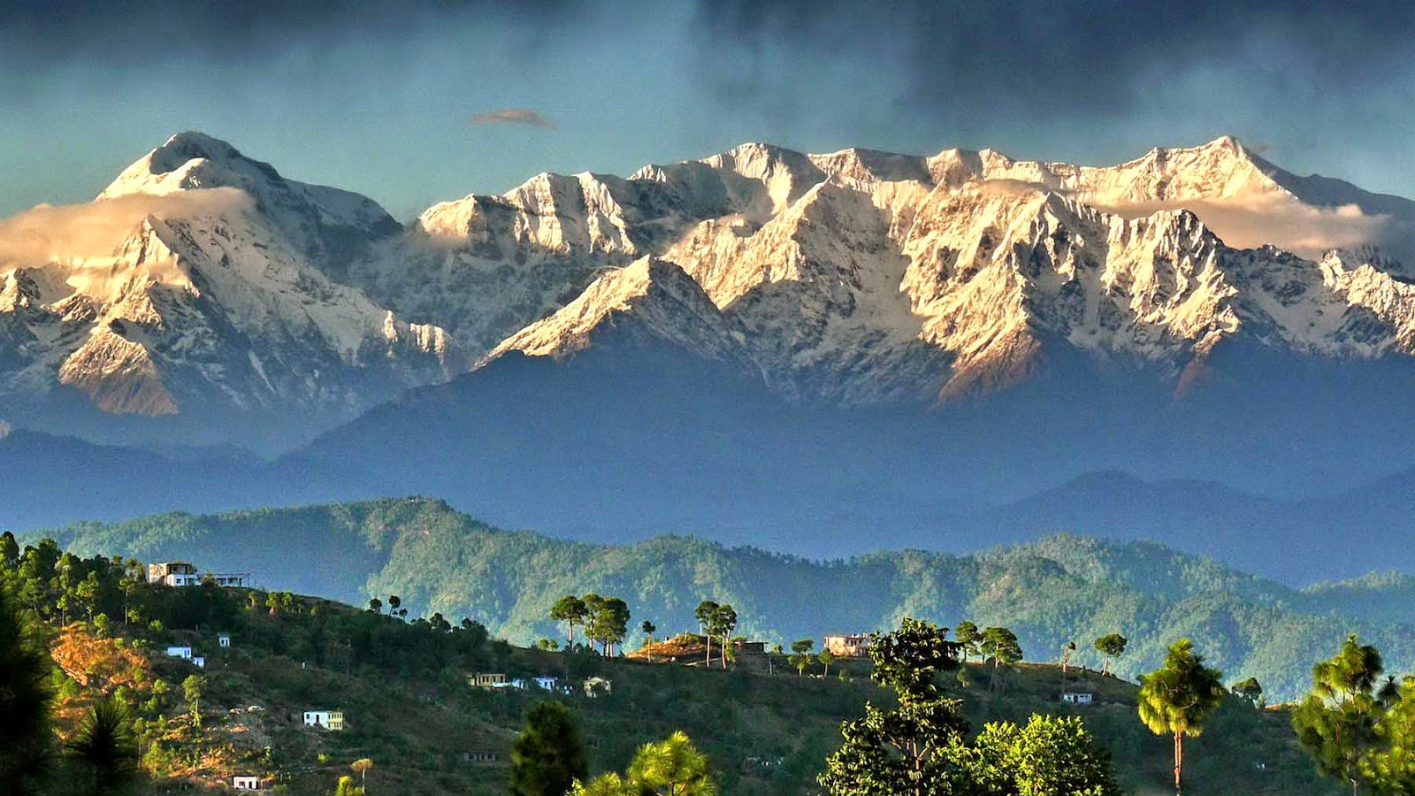
THANK YOU

