Slide 1

Presentation by Government of Uttar Pradesh on
UDAN - Regional Connectivity Scheme
Civil Aviation Department,
Government of Uttar Pradesh
July 7, 2017

Slide 2
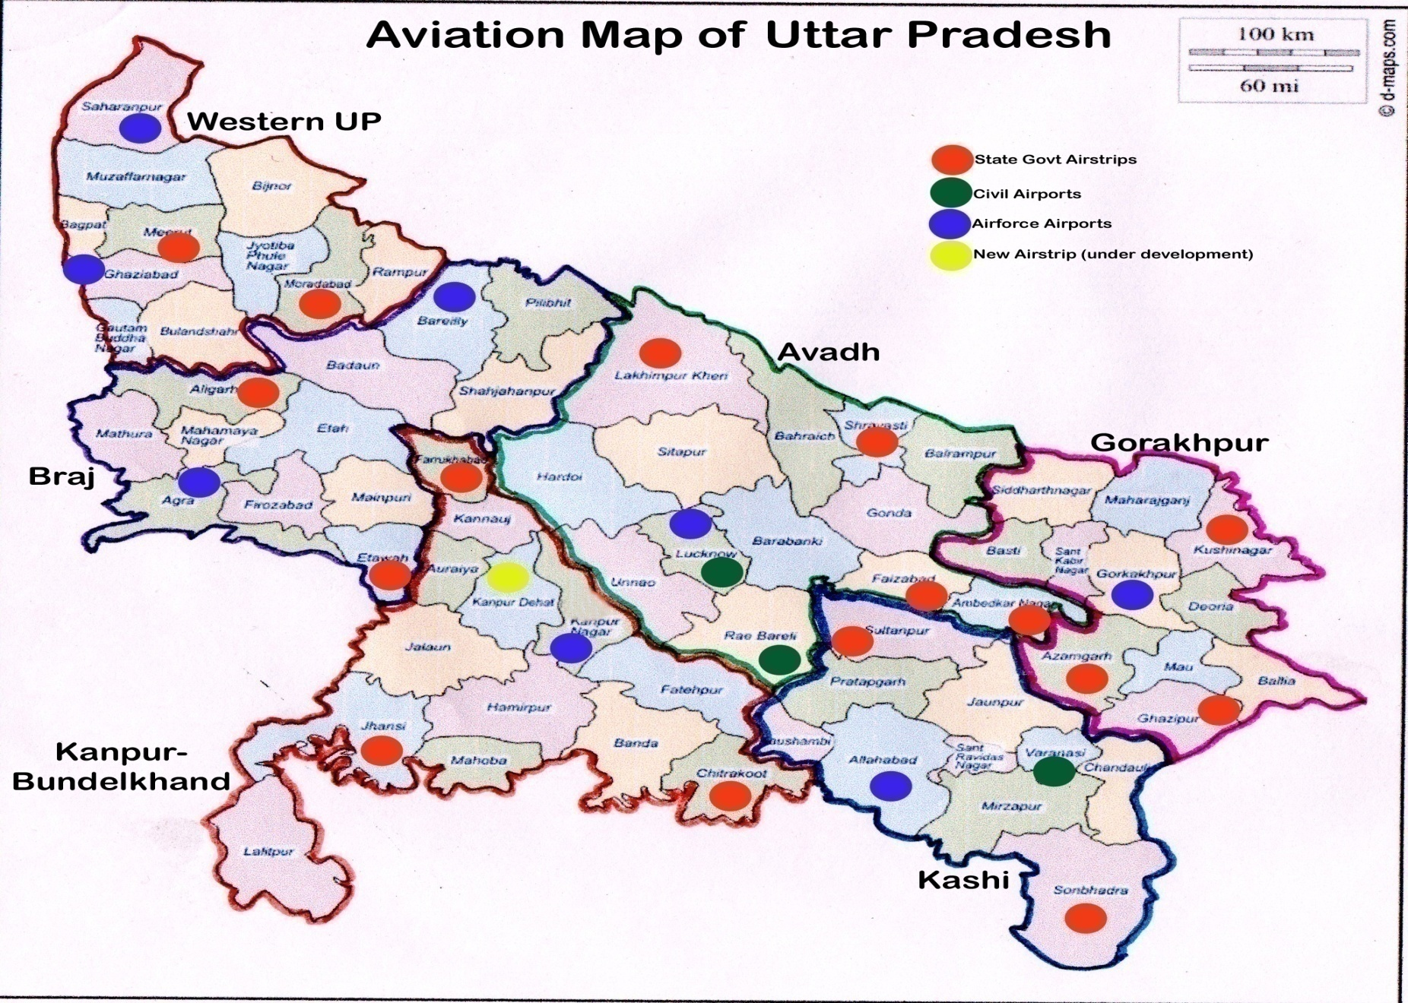
Aviation Infrastructure in Uttar Pradesh
Infrastructure
03 Civil Airports
08 IAF Airports
16 Airstrips
2

Slide 3
Civil / IAF Airports
Civil Airports
1. | Lucknow (International)
2. | Varanasi (International)
3. | Fursatganj (presently used by IGRUA)
IAF Airports
1. | Allahabad
2. | Agra
3. | Gorakhpur
4. | Kanpur
5. | Bareilly
6. | Saharanpur (Sarsawa)
7. | Gaziabad (Hindan)
8. | Lucknow (Baksi ka Talab)
3

Slide 4
Airstrips
District |  | Runway Dimension (Length X Width)
1. | Ambedkar Nagar | 1820 X 30 Mtr
2. | Gazipur | 1580 X 24 Mtr
3. | Sultanpur | 1500 X 30 Mtr
4. | Aligarh | 1240 X 25 Mtr
5. | Meerut | 1530 X 30 Mtr
6. | Farrukabad | 1228 X 24 Mtr
7. | Faizabad | 1530 X 30 Mtr
8. | Kushinagar | 3200 X 45 Mtr
District |  | Runway Dimension (Length X Width)
09 | Sonbhadra | 1422 X 25 Mtr
10 | Kheri | 1640 X 23 Mtr
11 | Shravasti | 1450 X 23 Mtr
12 | Moradabad | 2238 X 30 Mtr
13 | Etawah | 2500 X 45 Mtr
14 | Azamgarh | 1400 X 23 Mtr
15 | Jhansi | 1200 X 23 Mtr
16 | Chitrakoot | 2500 X 45 Mtr
4

Slide 5
Network/Routes in UP awarded during the First round of Bidding
Selected Airlines | Network/ Routes
SpiceJet | Delhi> Kanpur >Delhi
Alliance Air | Agra> Jaipur >Agra
Deccan Charters | Delhi > Agra > Delhi
Air Odisha | Delhi> Kanpur > Varanasi>Kanpur> Delhi
6

Slide 6
Concession / Support provided by Government of Uttar Pradesh
Concession / support
Reduction of VAT on ATF to 1% at RCS Airports.
Provision of security and fire services free of cost at RCS Airports.
Provisions of electricity, water and other utility services at substantially concessional rates at RCS Airports.
Reimbursement of the State Government’s share at 20% towards VGF for respective RCS Routes.
Additional Incentive
Underwriting of 30 % of Non-VGF Seats
U.P. state government will consider incentives or concessions as per the requirements of airlines to operate any RCS route having one airport in U.P.
Airlines may submit their proposals for any route having one leg in U.P. along with additional benefits they need to sustain operation preferably within 15 days.
6

Slide 7
New intrastate routes proposed to be included in RCS 2nd bidding
Lucknow-Bareilly-Meerut-Bareilly-Lucknow
Allahabad-Bareilly-Meerut-Bareilly-Allahabad
Lucknow-Moradabad-Saharanpur-Moradabad-Lucknow
Lucknow-Agra-Ghaziabad-Agra-Lucknow
Lucknow-Aligarh-Ghaziabad-Aligarh-Lucknow
Lucknow-Shravasti-Gorakhpur-Kushinagar-Sarnath-Kushinagar-Gorakhpur-Shravasti-Lucknow
Lucknow-Azamgarh-Lucknow
Lucknow-Jhansi-Lalitpur-Jhansi-Lucknow
Kanpur-Faizabad(Ayodhya)-Allahabad (Prayag)-Faizabad-Kanpur
Lucknow-Myorpur(Sonbhadra)-Chitrakoot-Myorpur-Lucknow

Slide 8
New interstate routes proposed to be included in RCS 2nd bidding
Lucknow-Gorakhpur-Patna-Gorakhpur-Lucknow
Delhi-Gorakhpur-Kathmandu-Gorakhpur-Delhi
Lucknow-Bareilly-Dehradun-Bareilly-Lucknow
Delhi-Bareilly-Allahabad-Bareilly-Delhi
Delhi-Allahabad-Delhi
Allahabad-Dehradun-Allahabad
Varanasi-Dehradun-Varanasi
Lucknow-Dehradun-Lucknow
Lucknow-Ranchi-Jamshedpur-Ranchi-Lucknow
Allahabad-Lucknow-Nagpur-Lucknow-Allahabad
Lucknow-Bhopal-Ujjain-Bhopal-Lucknow
Lucknow-Varanasi-Patna-Varanasi-Lucknow
Agra-Lucknow-Kolkata-Lucknow-Agra
Lucknow-Jhansi-Bhopal-Jhansi-Lucknow
Lucknow-Bhopal-Mumbai-Bhopal-Lucknow
Varanasi(Kashi)-Allahabad(Prayag)-Haridwar/Rishikesh(Jollygrant Airport, Dehradun)-Allahabad-Varanasi
Allahabad-Mumbai-Allahabad
Allahabad-Bengaluru-Allahabad

Slide 9
Additional Possible Viable Routes for Second round of bidding
Viable Routes
Meerut > Lucknow > Allahabad > Lucknow > Meerut
Moradabad > Lucknow > Allahabad > Lucknow > Moradabad
Agra > Lucknow > Allahabad > Lucknow > Agra
Chitrakoot > Faizabad > Varanasi
Delhi > Faizabad > Patna
Delhi > Bareilly > Lucknow > Bareilly > Delhi
Lucknow > Bareilly > Dehradun
Tourism Department of Govt. of U.P. shall also facilitate the marketing of routes.
Special Incentives can be considered in case District & Regional Headquarters are connected with State Capital.
State Government is open for any new suggestion.
6

Slide 10
Thank you

