Slide 1

Tamil Nadu
A presentation on airstrips with potential for development.

Slide 2
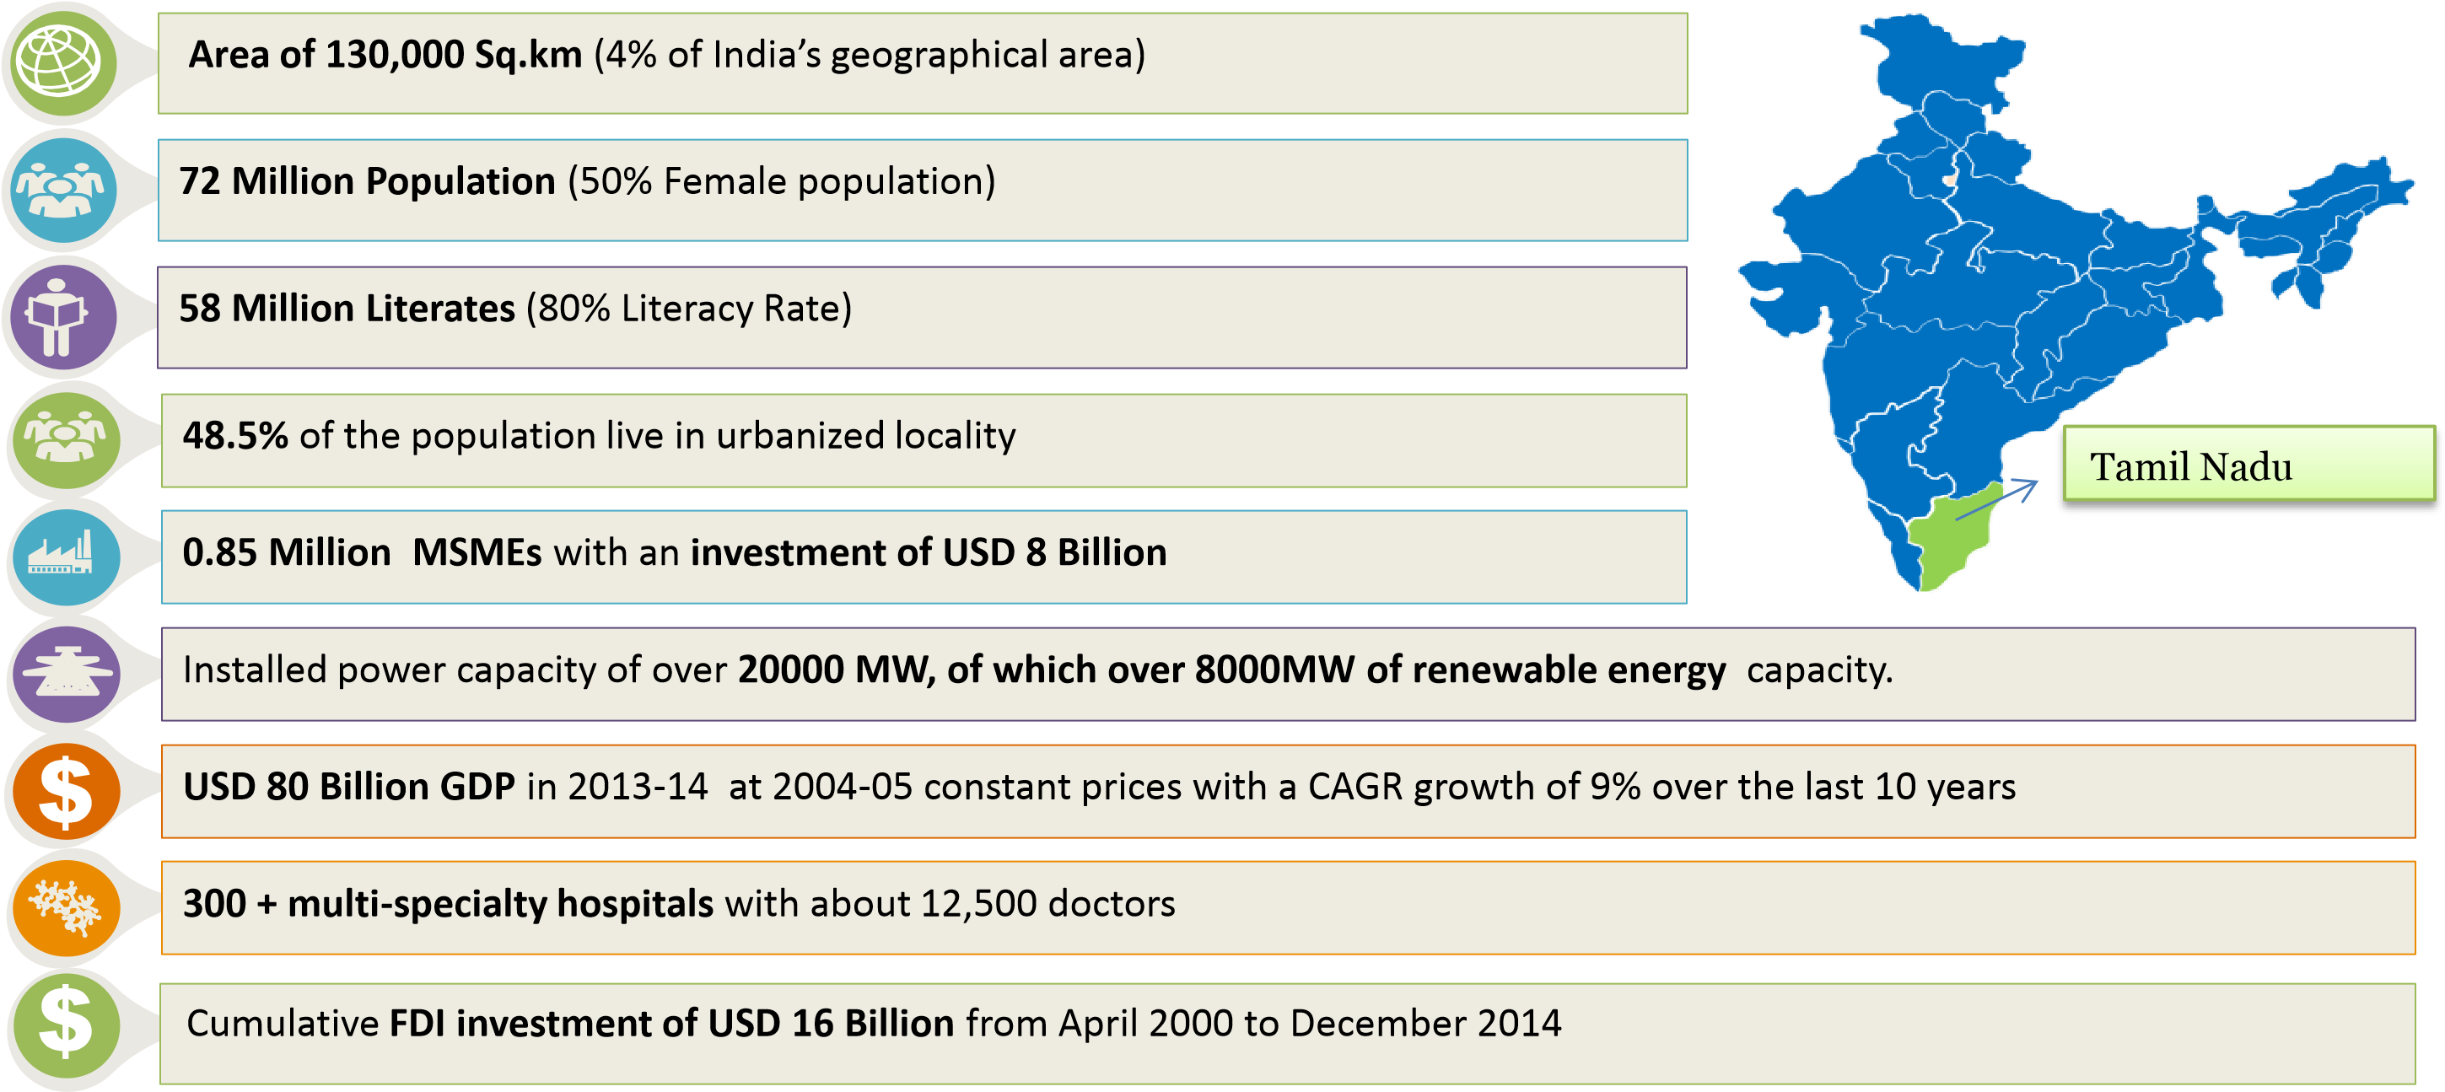
TAMIL NADU AT A GLANCE

Slide 3
Tamil Nadu – A Broad based Economy with presence of multiple sectors
–
Auto and Auto Components
Electronics hardware
IT & ITeS
Aerospace
Agro and Food Processing
Skill Development
Textiles
Chemicals and Petrochemicals
Heavy Engineering
Pharma and Biotechnology

Slide 4
Air Strips with potential for development
Thanjavur
Vellore
Rameswaram

Slide 5
THANJAVUR
  Cultural capital of the South.
  Temples for Navagrahas & myriad ancient Temples.
  More than 1000 tourists from Bangalore , 500 from Hyderabad & around 800 from Kerala visit Thanjavur daily.
  Thanjavur Big Temple – a big draw for foreign tourists.
  Airport owned by AAI.

Slide 6
VELLORE
On Chennai – Bangalore Highway
137 Kms from Chennai, 212 Kms from Bangalore.
Houses Christian Medical College ( CMC ) and VIT.
Centre of Leather cluster.
Airstrip extends over 51.5 acres , 760 metre runway.
Airport maintained by AAI.

Slide 7
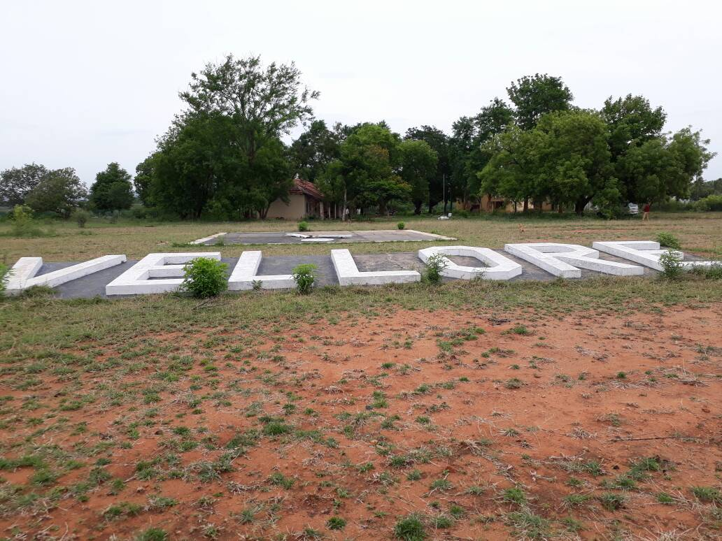

Slide 8
RAMESWARAM
Rameswaram – A famous pilgrimage & Tourist centre.
Dhanuskodi , Pamban , Devipattinam, Erwadi attract many tourists.
Nearly 3 lakh domestic tourists visit every month.
Nearest Airport at Madurai ( 180 Kms) .
INS Parundu Naval airfield near Uchupuli has runway of 920 meters.

Slide 9
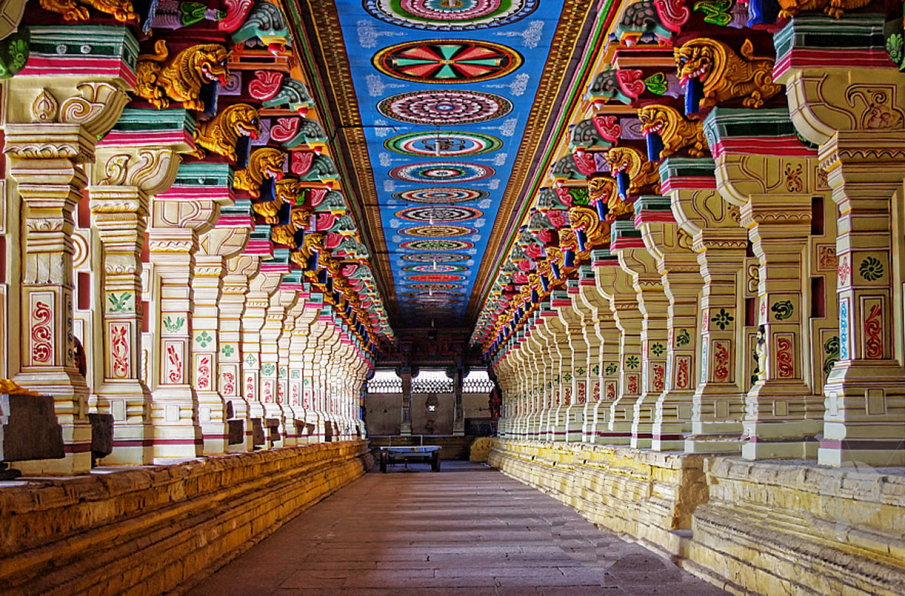
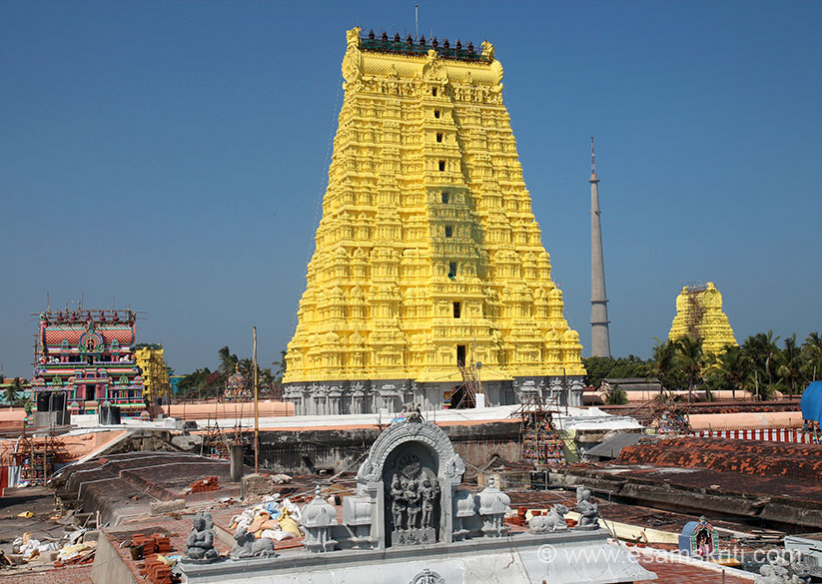
Rameswaram- Ramanatha Samy Temple

Slide 10
Incentives – UDAN Scheme
VAT on ATF reduced to 1 % from 9.6.2017.
All mandatory services will be provided by Government .
Airport / Route specific package can be considered.

Slide 11
Contacts
Mr. P.W.C. Davidar , IAS Addl.Chief Secretary to Government, Transport Department, Secretariat, Chennai - 600 009. | Tel: 91-44-25671475 Fax: 91-44-25670083 E-mail: transec@tn.gov.in URL: http://www.tn.gov.in
Mr.N.Muruganandam, IAS Principal Resident Commissioner Government of Tamil Nadu New Delhi-110021. | Tel: 91-11-24193460 Fax: 91-44-26119376 E-mail: prcofficetnh@gmail.com
Thank You

