Slide 1


REGIONAL CONNECTIVITY SCHEME (RCS)
-:KEY PARTNER:-
CIVIL AVIATION DEPARTMENT
GOVERNMENT OF RAJASTHAN

Slide 2
Vision / Objectives
Enhancing Inter/Intra State connectivity.
Promoting tourism & industries .
Development of more state owned airstrips.
Create more employment in the opportunites.

Slide 3
INCENTIVES BY GOVT. OF RAJASTHAN
GOR a key partner in RCS.
VAT on ATF is 5% in case any airline/operator establishes hub in Rajasthan.
VAT further reduced to 1% for RCS flight operations for the next 10 years.
Free of cost security & fire services available.
Sharing VGF under RCS and may consider underwriting of seats in addition.
May consider free of cost ambulance, night parking and other facilities at state owned airstrips.
May consider providing of electricity & water supply at concessional rates.
Free landing and parking on state owned airstrips.
Most of the state owned airstrips have runway length of 5000/6000ft and can be used for RCS flight operations.
Willing to develop required infrastructure at state owned airstrips in case any operator chooses to operate from any of these.

Slide 4
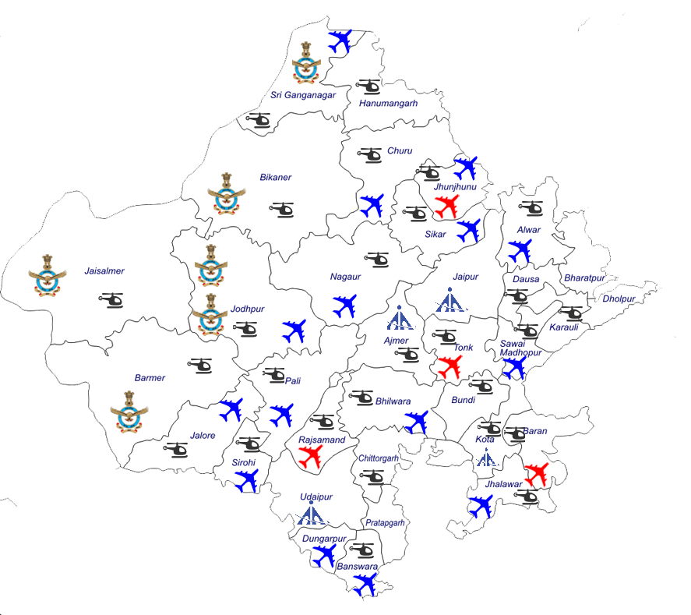




IMPORTANT AIRPORT/AIRSTRIPS
AIRPORTS
KOTA:- TOURIST PLACE/ MAJOR EDUCATIONAL & INDUSTRIAL HUB.
JODHPUR:-HISTORIC TOURIST PLACE, POPULAR FOR FILM/AD SHOOTINGS/DESTINATION WEDDINGS , HANDICRAFTS & DEFENSE ESTABLISHMENTS.
BIKANER:-RELIGIOUS & TOURIST PLACES.
UDAIPUR:-MAJOR TOURIST PLACE FAMOUS FOR LAKES & DESTINATION WEDDINGS.
AIRSTRIPS
SAWAI MADHOPUR:-FAMOUS FOR RANTHAMBHORE TIGER RESERVE .
JHALAWAR:-EDUCATIONAL HUB, PRIVATE UNIVERSITIES & COLLEGES .
SRI GANGANAGAR:-INDO-PAK BORDER, DEFENSE ESTABLISHMENT , AGRICULTURE RICH AREA, INDUSTRIES.
ABU ROAD:-HILL STATION , MINERAL INDUSTRIES , MOUNT ABU , TEMPLES.
JAISALMER-INTERNATIONAL TOURIST CENTRE FAMOUS FOR SAND DUNES, SONAR FORT ETC. MAJOR DEFENSE ESTABLISHMENTS.
BARMER:-MAJOR OIL FIELDS & PROPOSED REFINERY.
KISHANGARH :- RELIGIOUS TOURISM (PUSHKAR & DARGAH) , MARBLE INDUSTRY
BHILWARA :- TEXTILE HUB.
BHARATPUR :- WORLD FAMOUS GHANA BIRD SANCTUARY .
IAF-
State airstrip-
Private airstrip-
AAI-

Slide 5
PROBABLE ROUTES
S NO | PARAMETER | Sawai Madopur (state airstrip) | BIKANER CIVIL ENCLAVE (AAI) | LALGARH, SRIGANGANAGAR (State airstrip) | KOTA AAI AIRPORT (UNSERVED) | JAISALMER (DEFENSE AIRPORT) | JHALAWAR (State airstrip)
1. | Nearest operational airport | Jaipur | Jodhpur | Amritsar | Jaipur | Jodhpur | Jaipur
2. | Tourism Potential | Sanctuary, religious places HIGH | Religious places , Craft factories , camping HIGH | Indo-Pak border, Religious places MEDIUM | Religious places , Historic locations, Museum , wildlife sanctuary HIGH | Museums , Religious places , Camping HIGH | vibrant flora and fauna, forts, thick forests, exotic wild life
3. | Industry potential | Industries | Food based industries | Thermal station, Power transmission | Education institutional hub, thermal power, Hydro power plant | Agro based industries ,stone based industries, wood industry | Thermal station, Power transmission
4. | Rail connectivity | Sawai Madhopur junction | Bikaner Junction | Sri Ganganagar Railway Station | Kota junction | Jaisalmer railway station | Jhalawar railway station
5. | Terminal Capacity | Arrival-50 Dept-50 | Arrival-50 Dept-50 | N/A | Arrival-50 Dept-50 | Arrival-125 Dept-125
6. | Airfield authority | State airstrip | Civil Enclave | State airstrip | State airstrip | Civil Enclave | State airstrip
7. | Runway capacity |  | ATR-72 | ATR-72 | DO-228 | A-320 | A-320
8. | Runway Length | 3700ft | 4875ft | 4200ft | 4080ft | 9000ft | 5700ft
9. | Provision for night landing | No | No | No | No | No | No
10. | Addl. Land to be acquired |  | Present land Available (37.78 acres) |  | Present land Available (441.24acres) | Present land available (77.60 acres)

Slide 6
Minimum commitments from Selected Airlines
Fixed-wing aircraft: 50% of seats offered on an RCS Flight (subject to a minimum and maximum of 9 seats and 40 seats respectively) to be sold at or below specified Airfare Cap
Helicopters: 5 Seats to be sold at or below specified Airfare Cap
Frequency: Minimum 3 Flights per week and Maximum 7 Flights per week

Slide 7
STATE OWNED AIRSTRIPS
RUNWAY LENGTH 5000 FT AND ABOVE
S.NO | Name of Air strip | District | Flying time from Jaipur [hh:mm] | Dimension of Runway (in feet) | Surface | Owner/ Operator | Class of aircraft permitted to operate
01 | Tilwara | Banswara | 00:50 | 6192 x 30 | Bitumen | State Govt. | Heavy (Airliner)
02 | Hamirgarh | Bhilwara | 00:35 | 6000 x100 | Bitumen | State Govt. | Heavy (Airliner)
03 | Kolana | Jhalawar | 00:35 | 5700 x100 | Bitumen | State Govt. | Heavy (Airliner)
04 | Sirohi | Sirohi | 01:00 | 5904 x 100 | Bitumen | State Govt. | Heavy (Airliner)
05 | Tarpura | Sikar | 00:15 | 5023 x 100 | Bitumen | State Govt. | Heavy (Airliner)
06 | Pratapgarh | Pratapgarh | 00:45 | 5200 x 100 | Bitumen | State Govt. | Heavy (Airliner)
07 | Jhunjhunu | Jhunjhunu | 00:20 | 5000 x 100 | Bitumen | State Govt. | Heavy (Airliner)
08 | Nagaur | Nagaur | 00:35 | 5000 x 100 | Bitumen | State Govt. | Heavy (Airliner)
09 | Parihara Ratangarh | Churu | 00:30 | 5000 x 100 | Bitumen | State Govt. | Heavy (Airliner)
10 | Noon | Jalore | 00:50 | 5000 x 100 | Bitumen | State Govt. | Heavy (Airliner)

Slide 8
STATE OWNED AIRSTRIPS
RUNWAY LENGTH BELOW 5000 FT
“Willing to develop required infrastructure at state owned airstrips in case any operator choose to operate on it”
S.NO | Name of Airstrip | District | Flying time from Jaipur [hh:mm] | Dimension of Runway (in feet) | Surface | Owner/ Operator | Class of aircraft permitted to operate
11 | Dowra | Dungarpur | 00:55 | 4900 x 100 | Bitumen | State Govt. | Light (9 Seater)
12 | Lalgarh | Shri Ganga Nagar | 00:50 | 4200 x 100 | Bitumen | State Govt. | Light (9 Seater)
13 | Phalodi | Jodhpur | 00:50 | 4875 x 60 | Bitumen | State Govt. | Light (9 Seater)
14 | Thanagazi | Alwar | 00:15 | 3445 x 100 | Bitumen | State Govt. | Light (7 Seater)
15 | Abu Road | Sirohi | 01:05 | 3800 x 50 | Bitumen | State Govt. | Light (7 Seater)
16 | Bharatpur | Bharatpur | 00:25 | 3200 x 100 | Bitumen | State Govt. | Light (7 Seater)
17 | Sojat | Pali | 00:35 | 3600 x 50 | Bitumen | State Govt. | Light (7 Seater)
18 | Swai Madhopur | Swai Madhopur | 00:15 | 3700 x 100 | Bitumen | State Govt. | Light (7 Seater)

Slide 9
Rajasthan is the first State connected with Intra State Air Services .State government is providing VGF to the air operator . Presently , this air service is available on following routes:-
Jaipur – Jodhpur - Jaipur
Jaipur - Udaipur – Jaipur
Jaipur- Bikaner – Jaipur

Slide 10
Proposed New Routes For Intra State
(To be commenced shortly)
DELHI-KOTA- JAIPUR-DELHI
DELHI-SAWAI MADHOPUR-DELHI
DELHI – KISHANGARH-DELHI
DELHI – SRIGANGANAGAR-JAIPUR-DELHI
JODHPUR-AHMEDABAD-JODHPUR
JAIPUR – JODHPUR-JAISALMER-JODHPUR-JAIPUR

Slide 11
Tourist Per year in Rajasthan
2013-2014 |  | 2014-2015 |  | 2015-2016 |  | 2016-2017
Indian | foreigner | Indian | foreigner | Indian | foreigner | Indian | foreigner
30298150 | 1437162 | 33076491 | 1525574 | 35187573 | 1475311 | 41495115 | 1513729

Slide 12
“Willing to develop required infrastructure at state owned airstrips in case any operate choose to operate on it”
DIRECTORATE OF CIVIL AVIATION, GOVERNMENT OF RAJASTHAN

