Slide 1

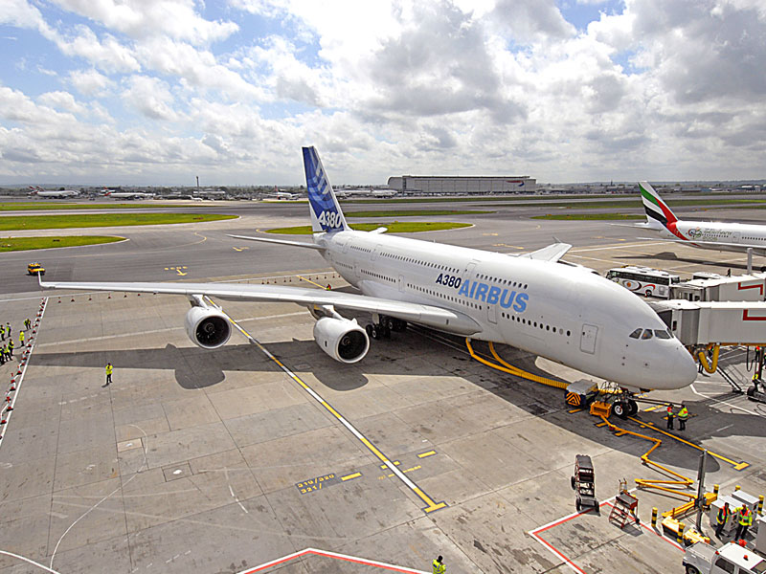

Maharashtra Airport Development Company Ltd. (MADC)
Presentation on Regional Air Connectivity in Maharashtra

Slide 2
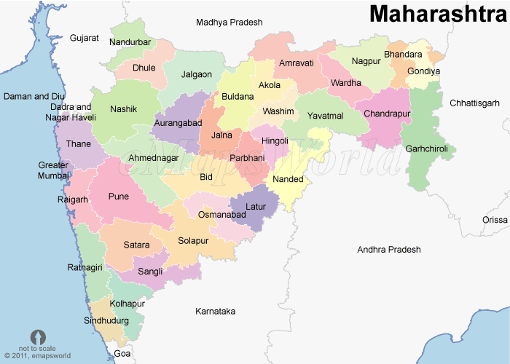

Airport Map of Maharashtra
Shirpur
Shirdi
Juhu
Raj Gurunagar
AAI
MIAL
MIL
MIDC
MADCL
HAL
Private
CIDCO
MoD
IAF/ AAI
MIAL
Amby Valley
Navi Mumbai
Baramati
Phaltan
Hotagi
Karad
Boramani

Slide 3
Airports in Maharashtra under
Regional Connectivity Scheme (RCS)
Sr. No | Airport | Operator/Owner | Runway Length (m)
1 | Kolhapur | AAI | 1,370
2 | Solapur (Hotagi) | AAI | 2,009
3 | Jalgaon | AAI | 1,700
4 | Amravati | MADC | 1,372
5 | Nanded | MIDC/Reliance | 2,300
6 | Sindhudurg | MIDC- IRB | 3170
7 | Ratnagiri | MoD - ICG | 1372
8 | Nasik | HAL | 3582
9 | Gondia | AAI | 2290

Slide 4
Incentives by Government of Maharashtra for RCS
  Existing airports at Mumbai,Pune,Nagpur & Aurangabad will not be covered under RCS but flight will originate or terminate at one of these airports from RCS airports.
  Rate of VAT applicable on ATF is 24% at Mumbai and Pune whereas it is 4% at Nagpur & Aurangabad. The GoM will bring VAT down to 1% on ATF sold at RCS approved Airports for a period of 10 Yrs & covered under RCS.
  The GoM is agreeable to the fare structure as proposed in policy.
  GoM is also agreeable to the concessions applicable to cargo operations & helicopter services.
  GoM will provide police & fire protection services free of charge to airport eligible under RCS.
  GoM agrees to provide power, water & other utilities at concessional rates.
  Land required for expansion of any existing airport eligible for RCS then GoM will make available minimum required land free of cost and free from all encumbrances

Slide 5
Incentives under consideration by Government of Maharashtra for RCS
  LTC to all employees of GoM upto their normal entitlement shall be granted by RCS flights.
  Creation of separate aviation Security wing by MSSC ( Maharashtra Security Corporation ) as per BCAS standards.
  GoM officers from class 2 and above rank shall be allowed to travel by RCS flights for Official duties.

Slide 6
  Thank You

