Slide 1
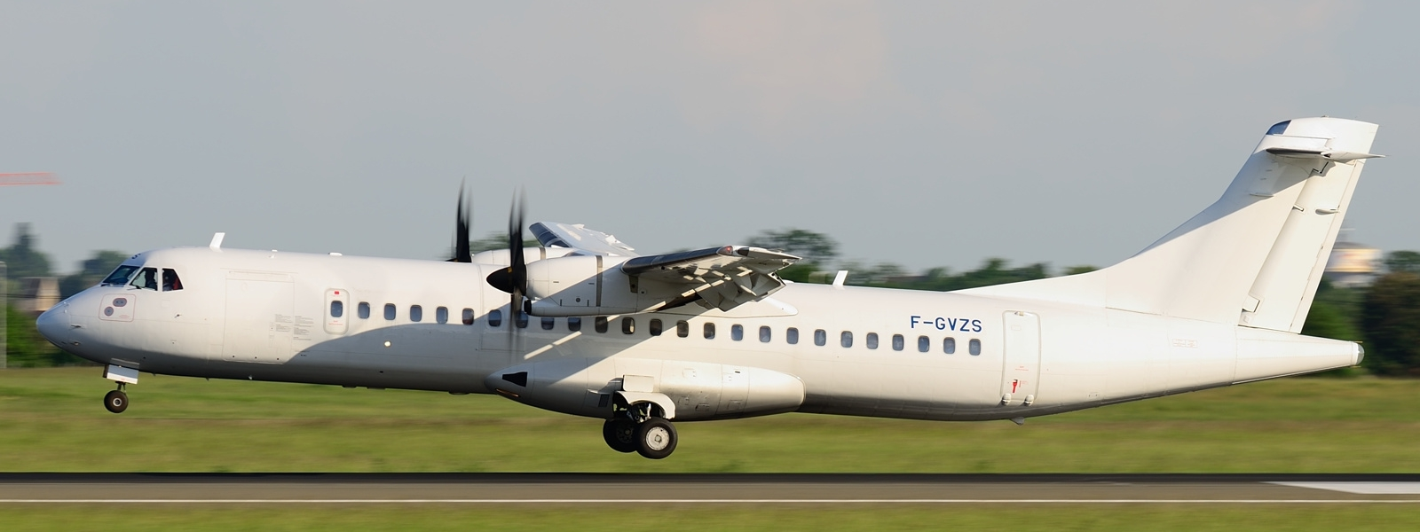
Development of Regional Connectivity Scheme in Karnataka
WINGS-2017 JULY 7, 2017

Slide 2
RCS - Action Taken By Karnataka
MoU has been signed between GoK & MoCA, GoI on 20th April 2017.
Concessions by Government of Karnataka under RCS :
For RCS Airports
Provide 20% share of VGF
Provide minimum land, if required-free of cost and free of encumbrances for RCS airports.
Provide security and fire services free of cost.
Provide electricity, water & other utility services at concessional rates.
For RCS Airline Operators
Reduction in Sales Tax (ST) to 1% on RCS airports (for 10 year) except Bangalore & Mangalore Airport (28%); and Hubli & Belgaum (4%)

Slide 3
Location of Proposed Airports and Airstrips in Karnataka
RCS –Airports
Bengaluru
Bidar
Mysuru
Vidyanagar
Ammasandra
Baldota/Koppal
Bagalkot*
Bellary*
Ginigera (Hospet)*
Hassan*
Jakkur*
Kolar
Raichur*
Shahbad*
Yadgiiri*
Yelahanka
Chikkamagaluru*
Karwar*
Kodagu (Madikeri)*
Legend:
Black Icons – Existing Airports
Green Icons – Greenfield Airports
Orange Boxes – Proposed Airstrips
Legend:
Airports Covered in 1st Round bidding
* Airports /Airstrips is to be developed

Slide 4
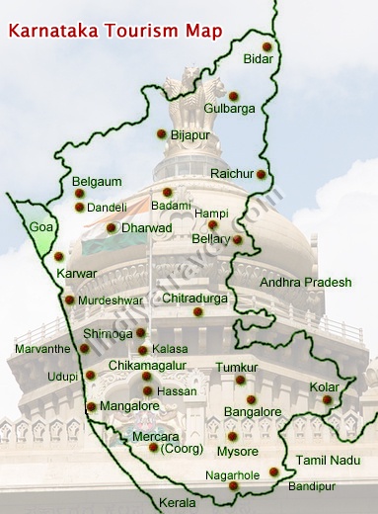
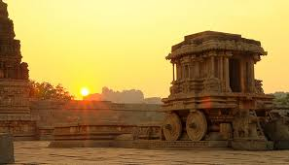
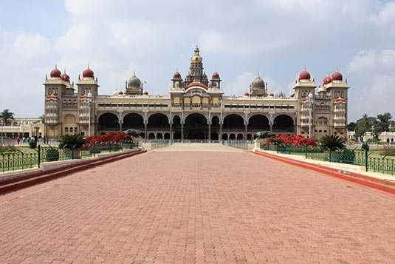
Tourism Locations
Major Tourism attraction in Karnataka :
World Heritage Centres
Hampi (Ballary), Pattadakal (Bagalkote)
Historical locations
Aihole, Badami, Basavakalyana (Bagalakote),
Belur, Halebidu, Shrvanabelgola, (Hassan) ,
Basavana Bagewadi, Golgumbaz (Vijapura),
Srirangapattana , Melkote (Mandya) etc.
Palaces
Mysore Palace (Amba Vilas), Jayalakshmi Vilas Mansion, Lalitha Mahal Palace, Jaganmohan Palace, Rajendra Vilas Palace, Cheluvamba Mansion ( Mysuru)
Bangalore Palace (Bangalore).
Daria Daulat Bagh (Mandya)
Shivappa Nayaka Palace (Shivamoga)

Slide 5
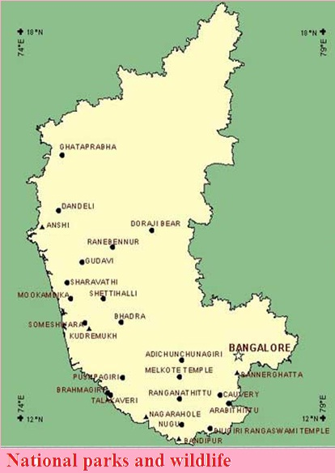
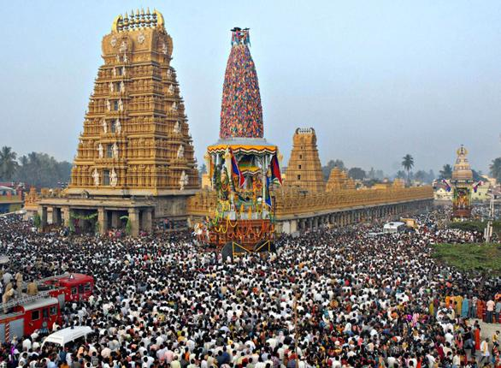
Karnataka Tourism Cont…
National parks and wildlife
21 wildlife sanctuaries and 5 National parks
Bandipur National Park, Bannerghatta National Park (Bengaluru)
Nagarhole National Park (Mysuru),
Kudremukh National Park & Bhadra Wildlife Sanctuary (Chikkamagaluru),
Dandeli & Anshi National Park and Wildlife Sanctuary (Uttar Kannada),
Bandipur National Park & Biligiriranga Swamy Temple Wildlife Sanctuary (Chamarajnagara),
Gudavi and Mandegadde bird sanctuaries,,
Ghataprabha Bird Sanctuary (Belagavi).
Pilgrimage :
Karnataka is the stronghold of Hindu and Jain pilgrimage spots
Banvasi, Bhatkal, Gokarna, Murudeshwar (Uttar Kannada)
Shrungeri, Horanadu, Bababudan, Kalasa (Chikkamagaluru)
Male Mahadeshwara Betta, (Mysuru)
Kudalasangama (Bagalkote)
Kotilingeshwara (Kolar), Sharana Basaveshwara (Vijayapura)
Video Clip

Slide 6
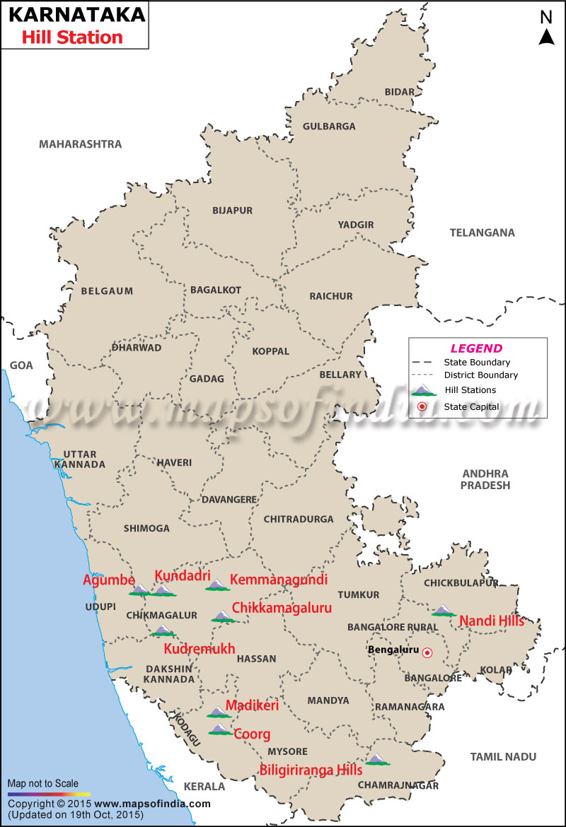
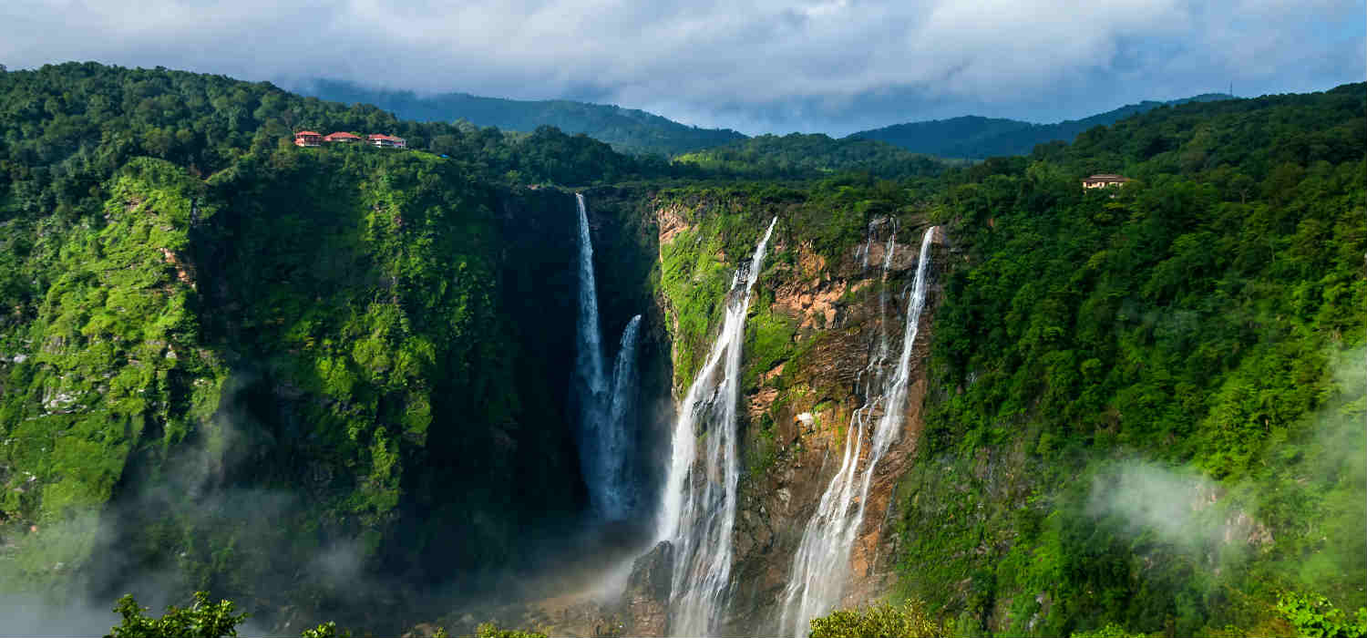
Karnataka Tourism Cont…
Hill Stations:
Kemmangundi, Mullayanagiri, Kudremukh, (Chikkamagaluru) Kodachadri, Kundadri, Agumbe (Shivamoga)
Biligiri Ranga, Male Mahadeshwara (Mysuru)
Nandhi Hills ( Chikkaballapura).
Devarayanadurga (Tumukuru)
Yana (Uttar Kannada)
Water Falls:
Manikyadhara, Kallathigiri, Hanumana Gundi (Chikkamagaluru)
Abby Falls, Iruppu Falls (Kadagu),
Jog Falls, Koodlu Theertha, Dabbe (Shivamoga)
Varapoha, Gokak (Belagavi)
Shivagange, Apsarakonda, Lalguli (Uttar Kannada)

Slide 7
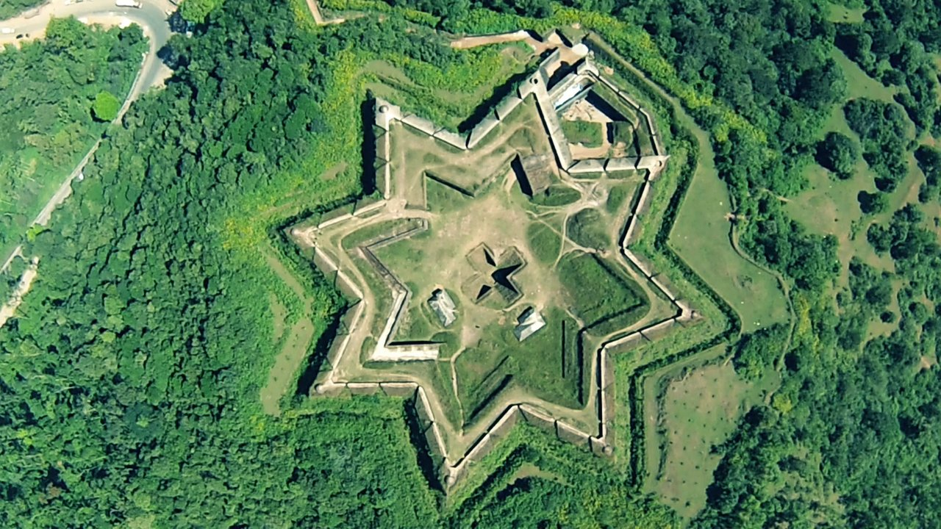
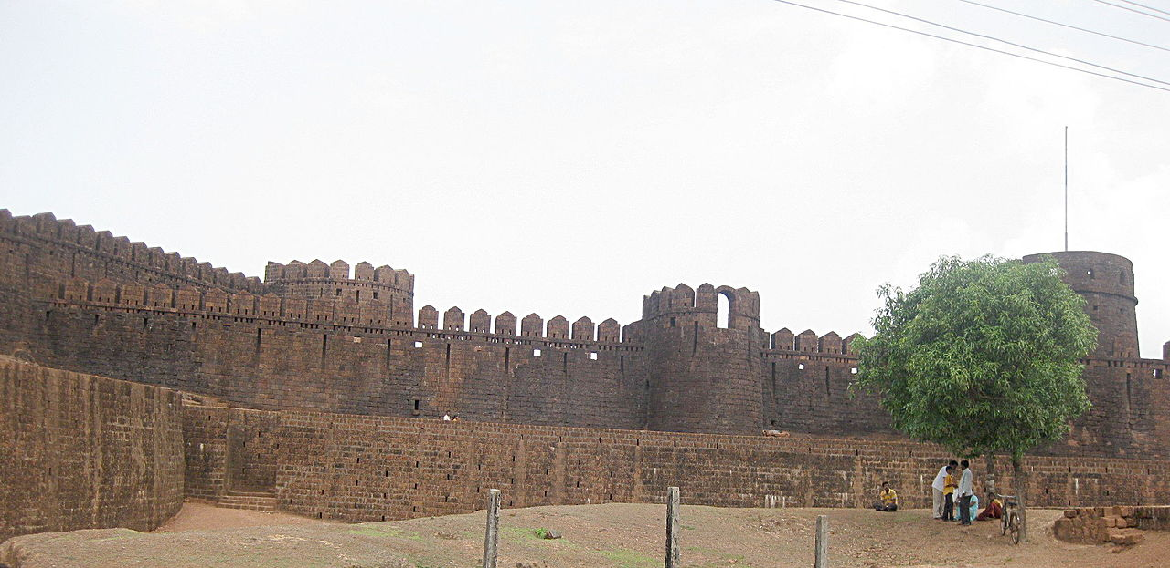
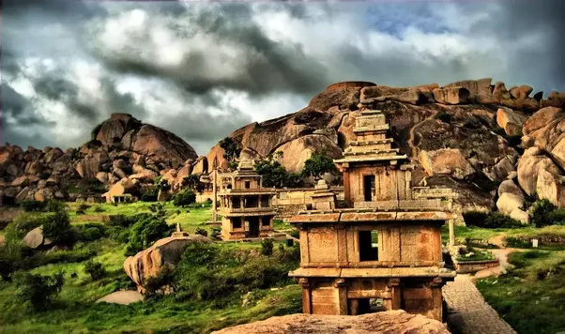
Karnataka Tourism Cont…
Forts
Kittur , Ramdurg, Gokak, (Belgavi)
Basavakalyana, Bhalki, Manyakheta (Bidar)
Chitradurga Fort, Hosadurga (Chitradurga)
Gajendrgad, Korlahalli, Hammigi (Gadag)
Manjarabad Fort (Hassan)
Mudgal, Malliabad, Jaladurga (Raichuru)
Kodachadri, Thirthalli, Nagara (Shivamoga)
Mirjan, Sadashivgad, Asnoti (Uttara Kannad)

Slide 8
State Requirements to Make it Attractive to Operation
Permission to operate HAL airport for Schedule and Non Scheduled aircrafts / Airlines.
Reduced to charges HAL airport at par with AAI charges.

Slide 9
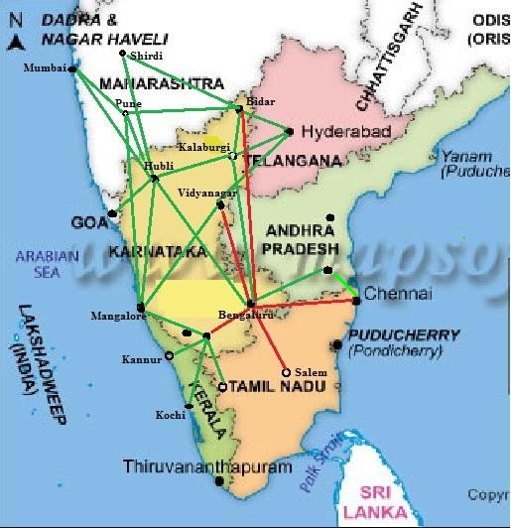
Potential Air Routes
Bengaluru- Kalaburgi- Bidar- Hyderabad
Bengaluru- Hubbali- Mangalore- Bengaluru.
Mangalore-Madikere-Mysuru-Bengaluru.
Mangalore- Vidyanagara – Hyderabad.
Mangalore- Hubbali- Pune
Mangalore-Hubbali-Pune.
Goa- Hubbali – Kalaburgi - Hyderabad.
Bengaluru - Hubbali –Belagavi- Shiradi.
Bengaluru - Hubbali –Belagavi-Pune- Mumbai
Bengaluru –Tirupati- Chennai
Bengaluru- Mysuru- Calicut-Kannur- Kochi.

Slide 10
Thank You
Notes:
References:
http://www.chickmagalur.nic.in/
http://www.censusindia.gov.in/2011census/dchb/2916_PART_B_DCHB_CHIKMAGALUR.pdf
http://www.chickmagalur.nic.in/htmls/cb_main.htm
http://www.indiacoffee.org/Market_Info.aspx
http://www.deccanherald.com/content/208232/15-cr-tourists-visited-chikmagalur.html
http://indianexpress.com/article/business/business-others/no-frills-airports-need-limited-private-participation/
http://www.aai.aero/misc/AAI_PR_Routes_22Sep14.pdf
http://des.kar.nic.in/sip_si_pub.asp
http://www.aai.aero/misc/AirportCharges2014-15-221114.pdf

