Slide 1

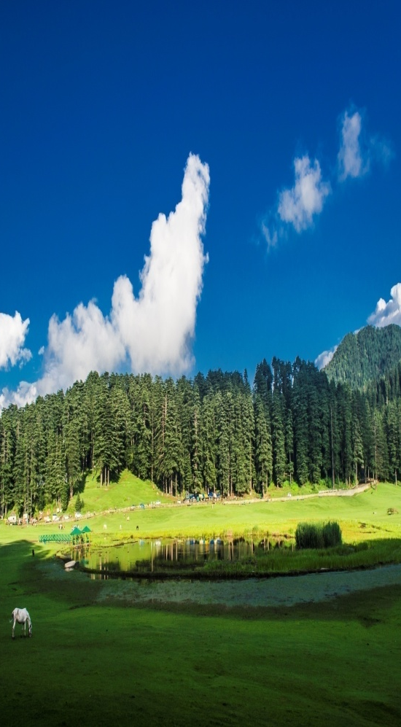
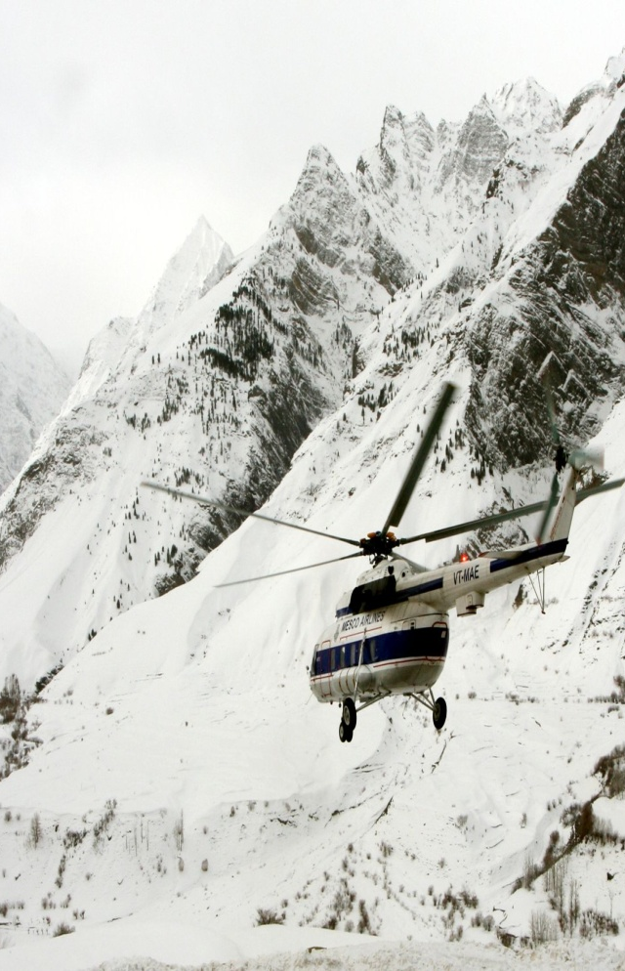
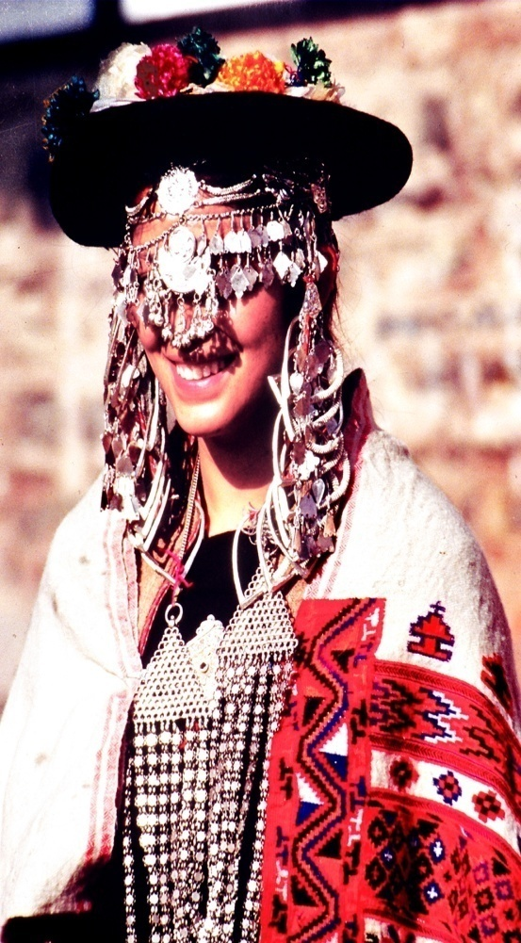
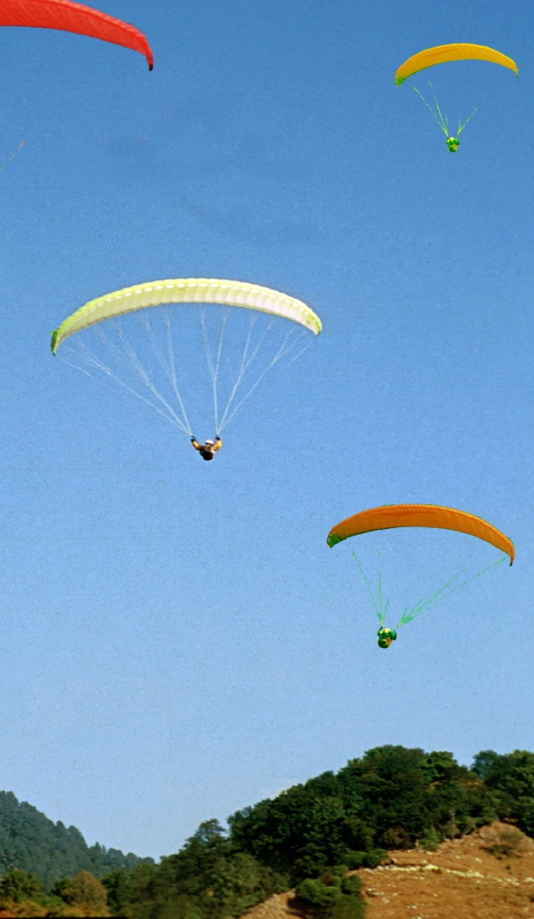
Tourism & Civil Aviation Department,
Himachal Pradesh

Slide 2

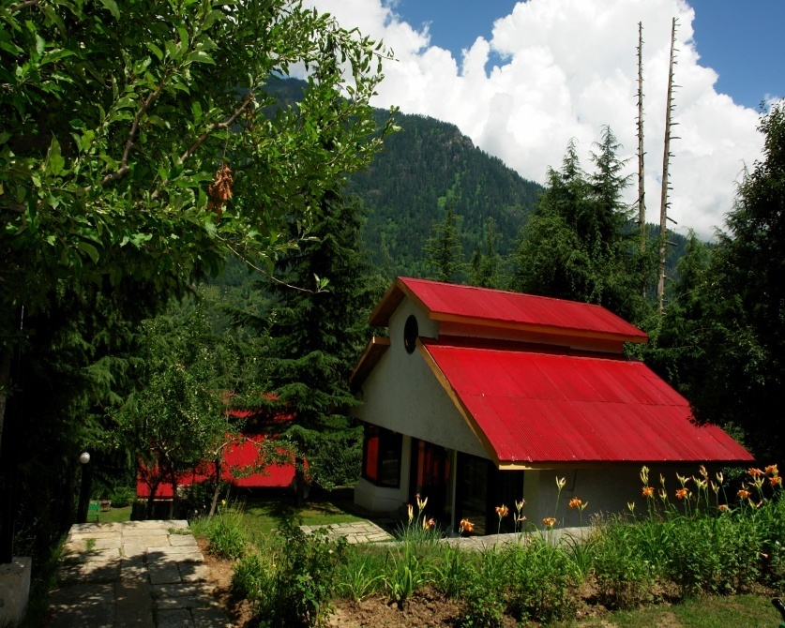
General Statistics on Tourism
HOTELS: 2784
HOME STAY UNITS 850
BED CAPACITY 80243
RESTAURANTS 644
TOURIST GUIDES 908
TRAVEL AGENCIES 2446
Share in SGDP 6.8%
Helipads 64
Airports 03
2015 | 4,06,108 | 1,71,25,045 | 1,75,31,153
2016 | 4,53,000 | 1,79, 98,000 | 1,84,51,000

Slide 3
Why Air Connectivity important for Himachal
Leading Tourist destination for International and Domestic tourists.
Shimla the queen of hills was summer capital of British Raj India.
Dharamshala is famous destination because of His Holiness the Dalai Lama.
Kullu-Manali a famous tourist destination because of beautiful landscapes and and adventurous activities
Strategically important for defence purpose as China border is approx at a distance of 300 km from the State capital.
The geographical area of the state is quite vast and state has 64 helipads available which can be used for Heli-Taxi services.

Slide 4
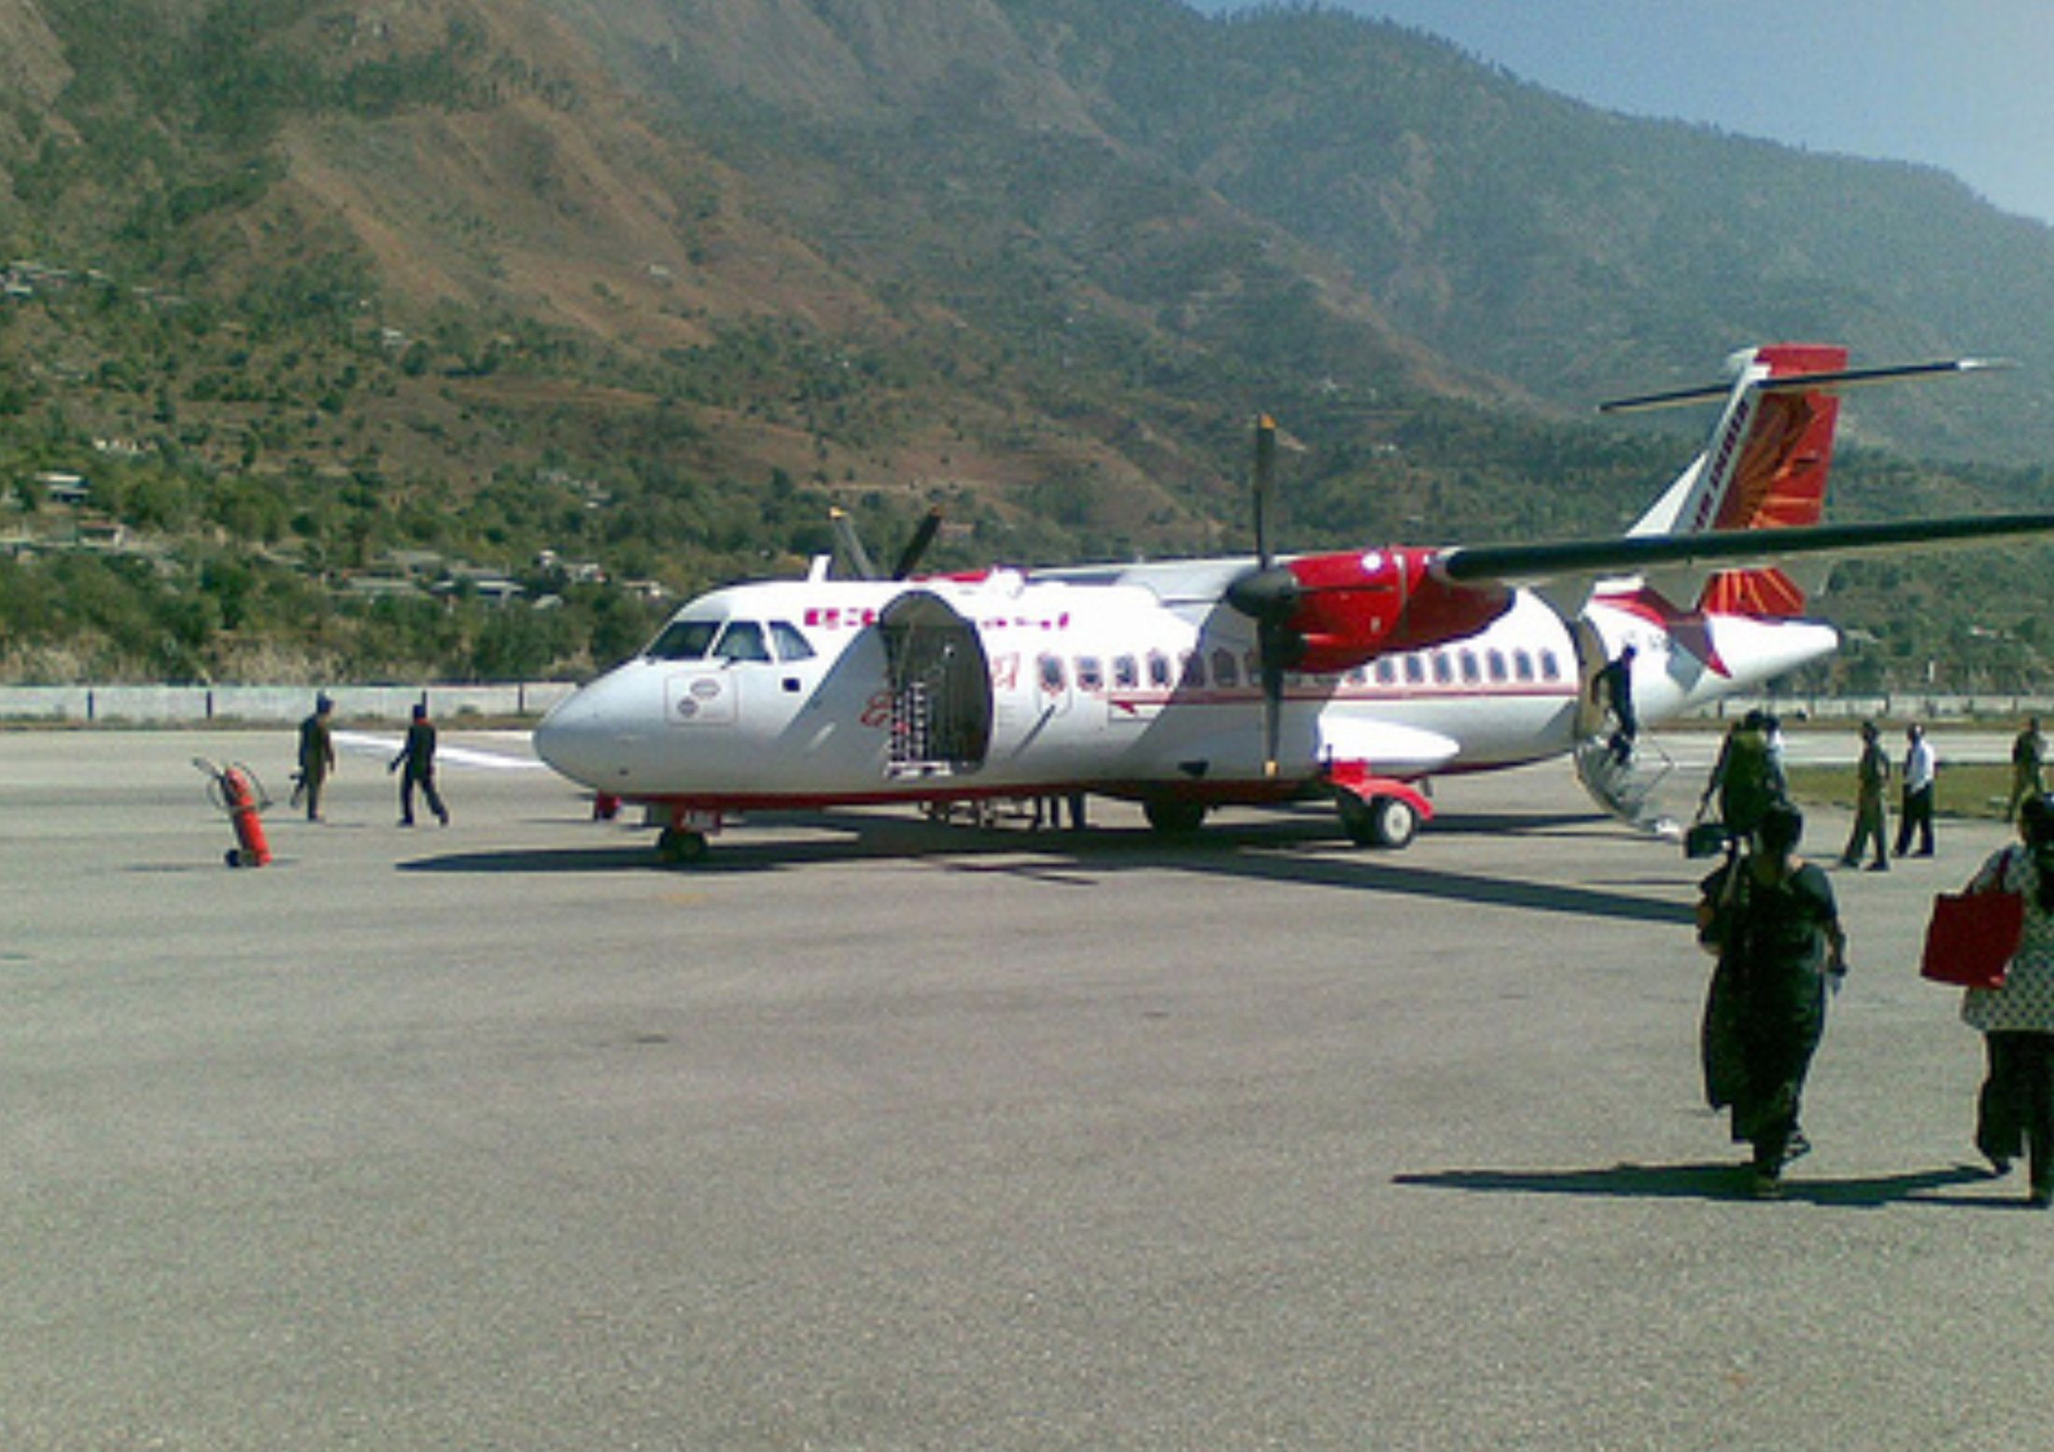
Kullu airport at Bhuntar
HIMACHAL PRADESH HAS THREE AIRPORTS LOCATED AT
GAGGAL NEAR DHARAMSHALA.
BHUNTAR NEAR KULLU.
JUBBARHATTI NEAR SHIMLA.

Slide 5
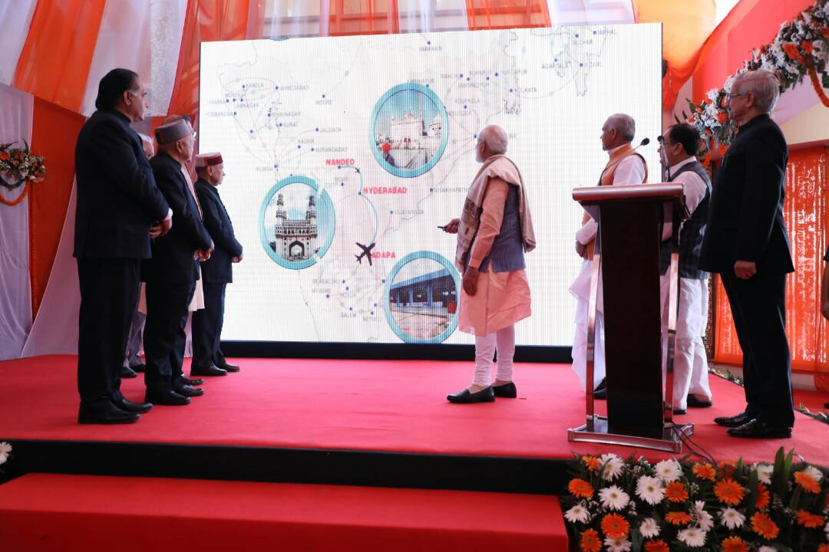
SHIMLA AIRPORT
  First flight under UDAN was inaugurated by Hon’ble Prime Minister on 27-04-2017 and flight under this scheme is operational to and from Delhi.
  Distance of Airport from Shimla town is 23 kms.
  Airport has an effective runway length of 1164 meters and width of 30 meters.
  Currently ATR 42 is being operated by the M/s Alliance Airline.
  Flight of M/s Air Deccan is expected to start from August, 2017.

Slide 6
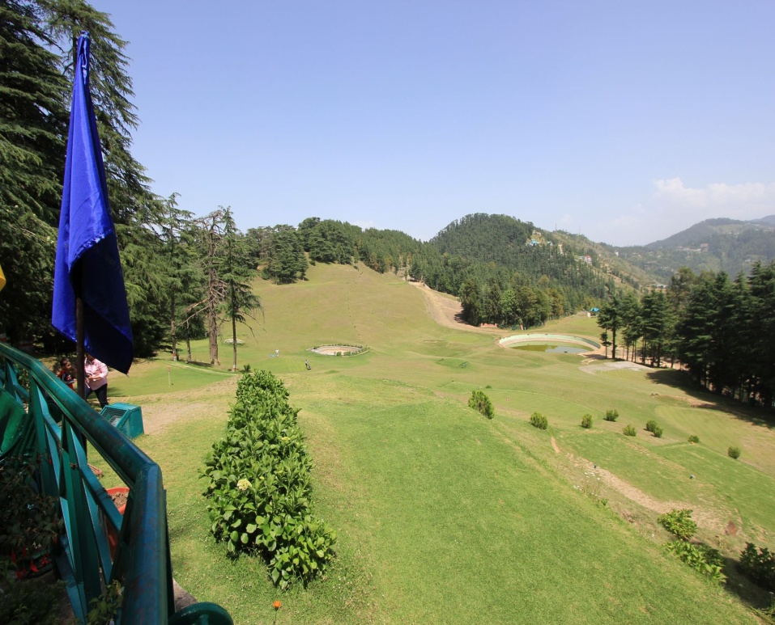

Tourist Places in and around Shimla
  Shimla Town, Tara Devi, Kufri, Fagu, Naldehra, Tatta Pani, Narkanda, Chail.
  Options for trekking, camping, skiing and mountain biking available.
Naldhera

Slide 7
Kullu Airport at Bhuntar
Airport has existing runway of 1128 mts. with a width of 30.5 mts.
Suitable for the landing of ATR 72 aircraft.
Flights of M/s Alliance Air are being operated.
Identified as under served Airport under RCS-UDAN. However, flight under UDAN not started yet.

Slide 8
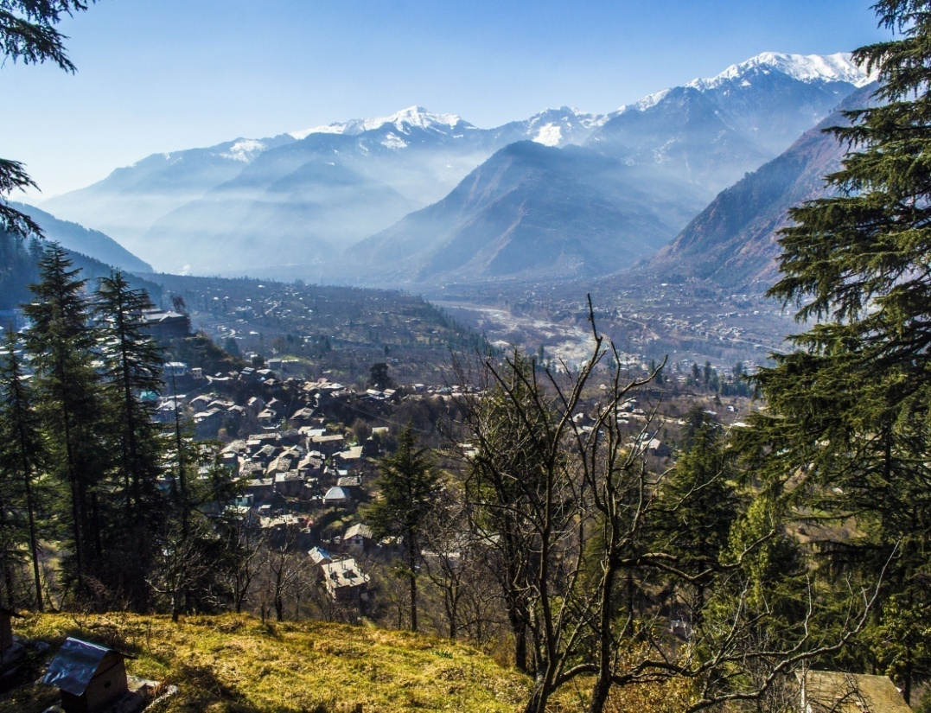
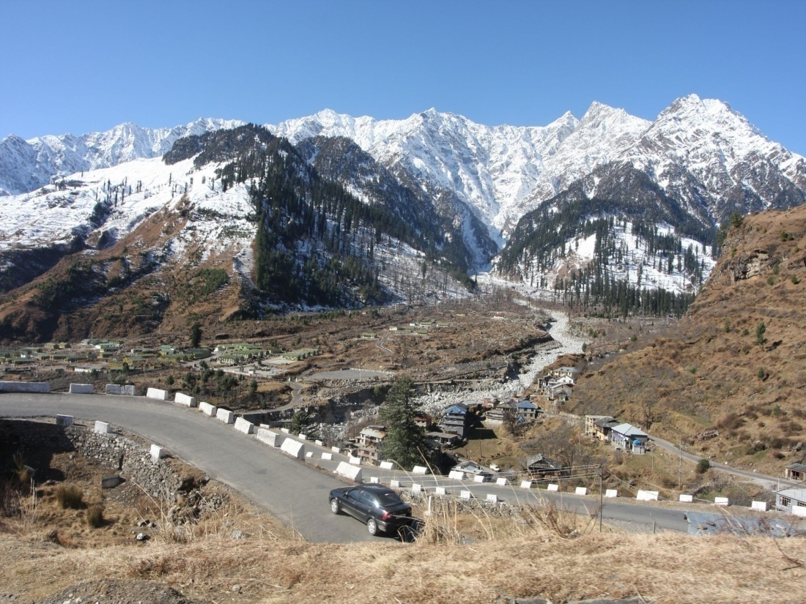
Tourist Places /activities in and around Kullu
  Kullu, Manikaran, Manali, Vashishth, Naggar, Solang, Rohtang Pass.
  Options for trekking, camping, river-rafting, Paragliding, Skiing etc.. are available.
Palchan
Kullu valley

Slide 9
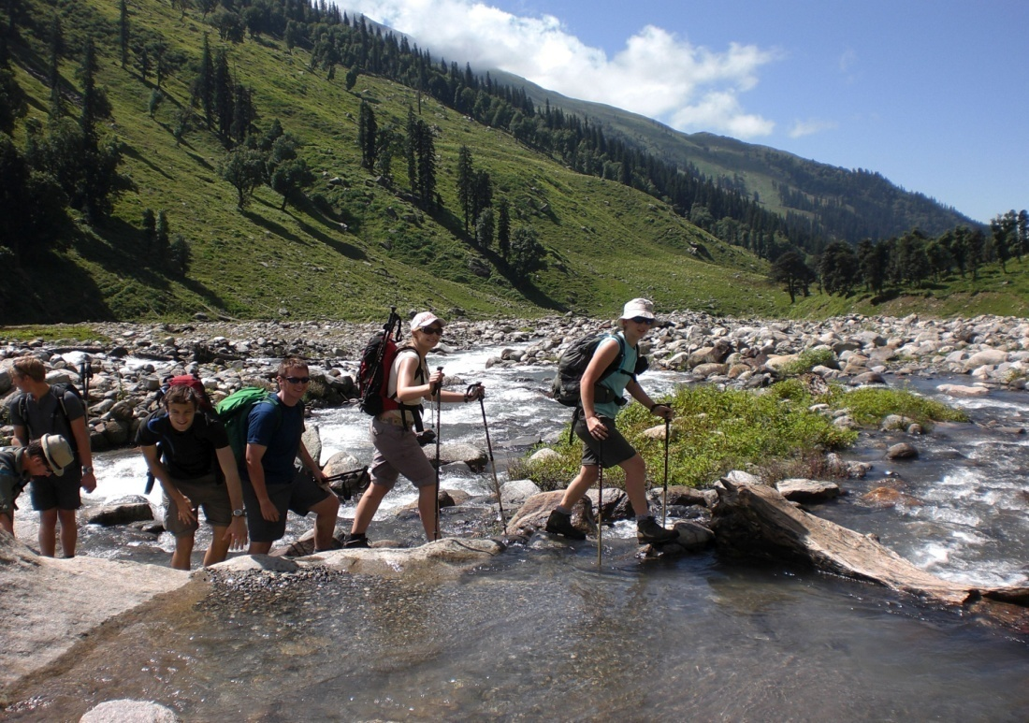
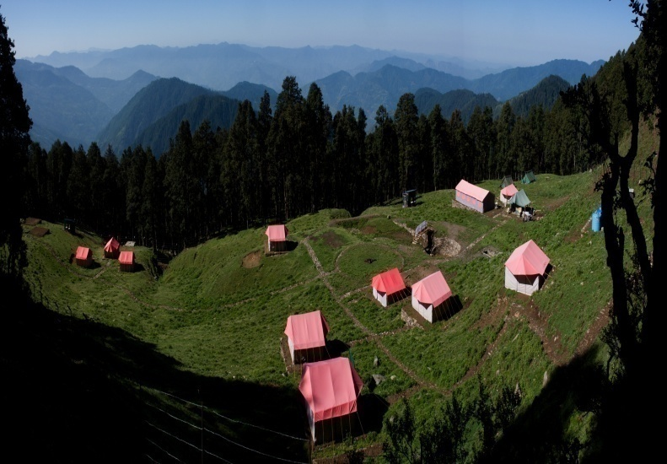
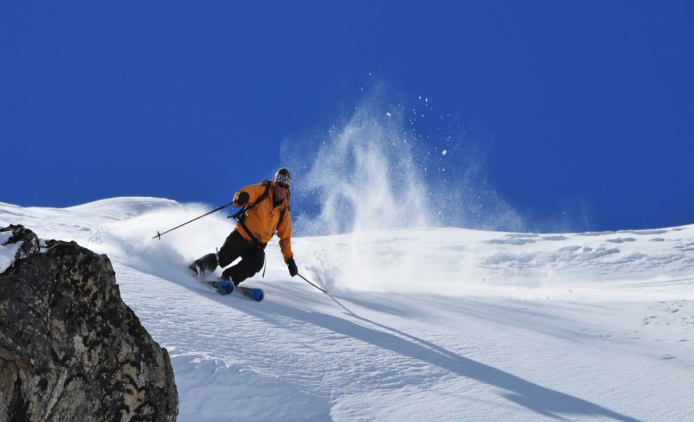
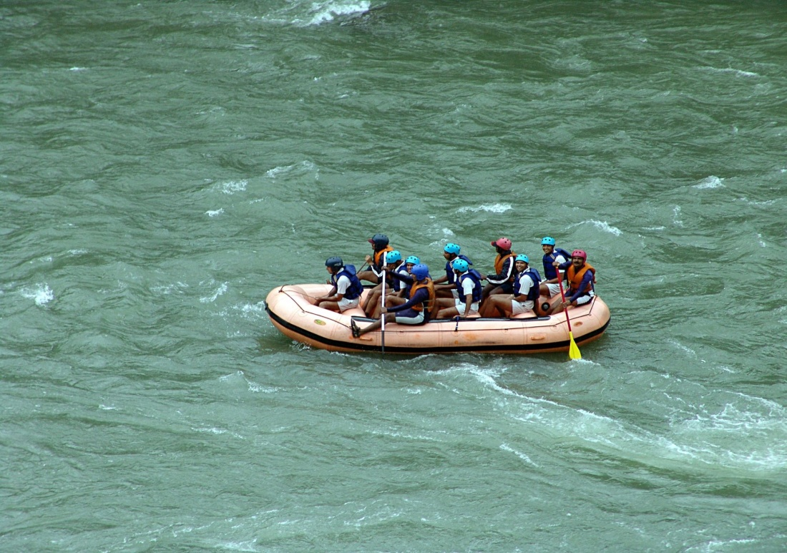
Hamta valley
Jalori Pass
Skiing at Jobri Top, Kullu
River-Rafting on Beas, Kullu

Slide 10
Kangra Airport at Gaggal
Airport situated at a distance of 15 km from Dharamshala.
The runway length of the Airport is 1372 mtr. and width 30 mtr.
Regular flights being operated by M/s Alliance Air and M/s Spice jet to and from Delhi.
Suitable for the landing of ATR 72 aircraft.

Slide 11
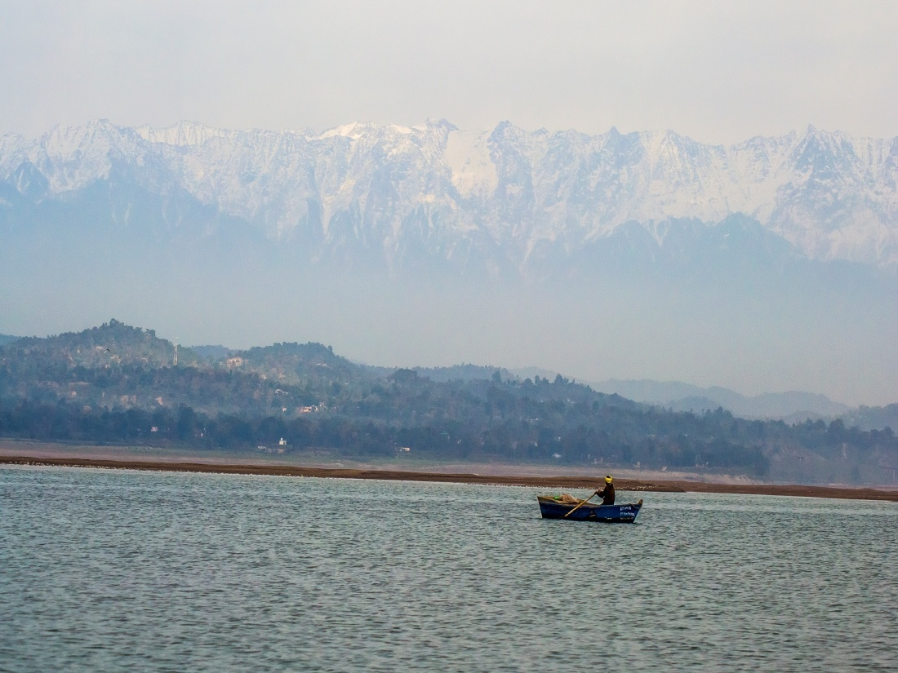
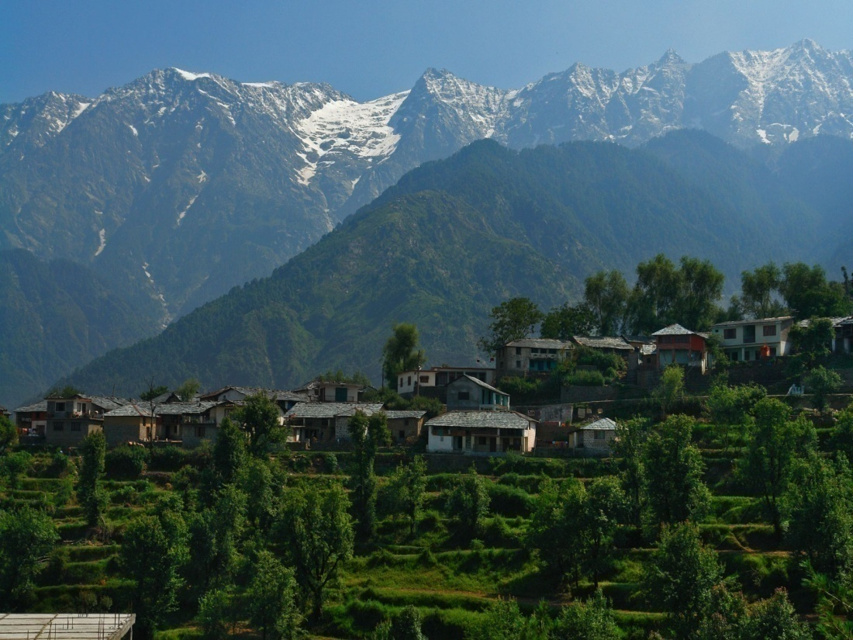
Places /activities in and around Dharamshala
  Dharamshala, Mcleodganj, Triund, Dal Lake, Bhagsu Nag, Chamunda Ji, Kangra Fort, Bajreshwari Devi temple, Masroor, Palampur, Jwalaji etc.
  Trekking, camping, Paragliding etc.. options available.
Maharana Pratap Sagar
Naddi near Mcleodganj

Slide 12
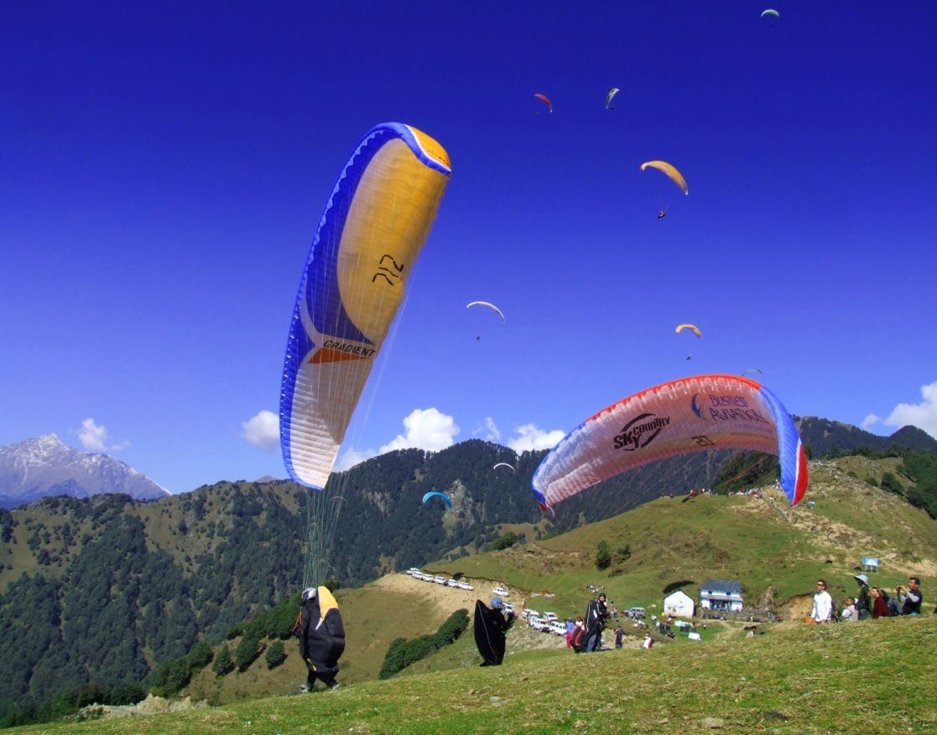
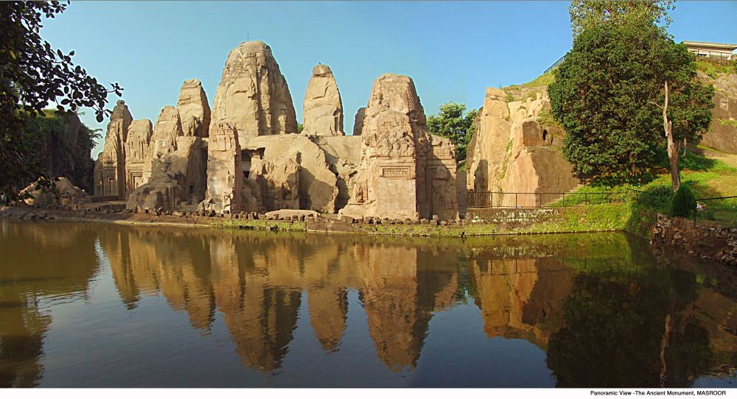
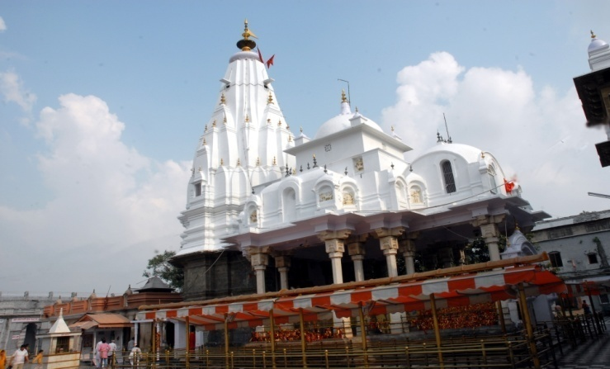
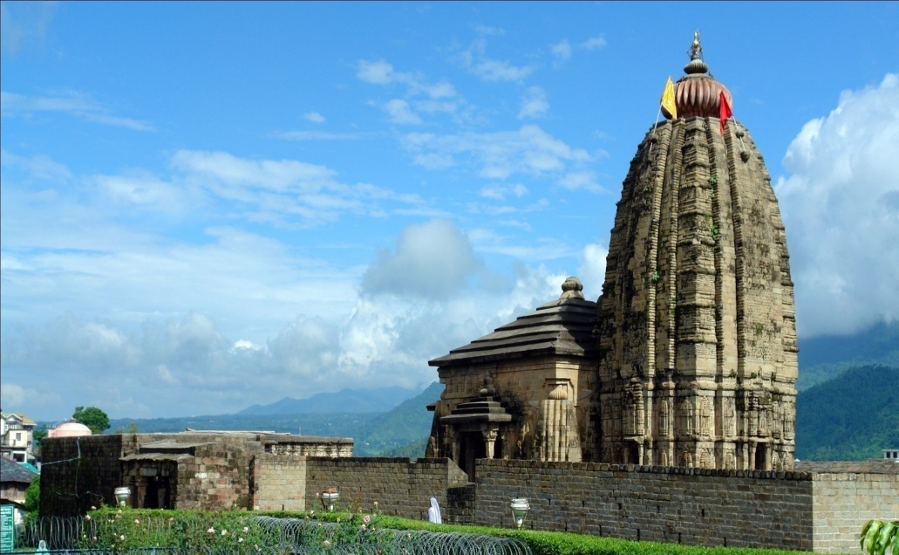
Rock-cut temples at Masroor, Kangra
Paragliding at Bir-Billing
Shiv Temple, Baijnath
Bajreshwari Devi Temple, Kangra

Slide 13
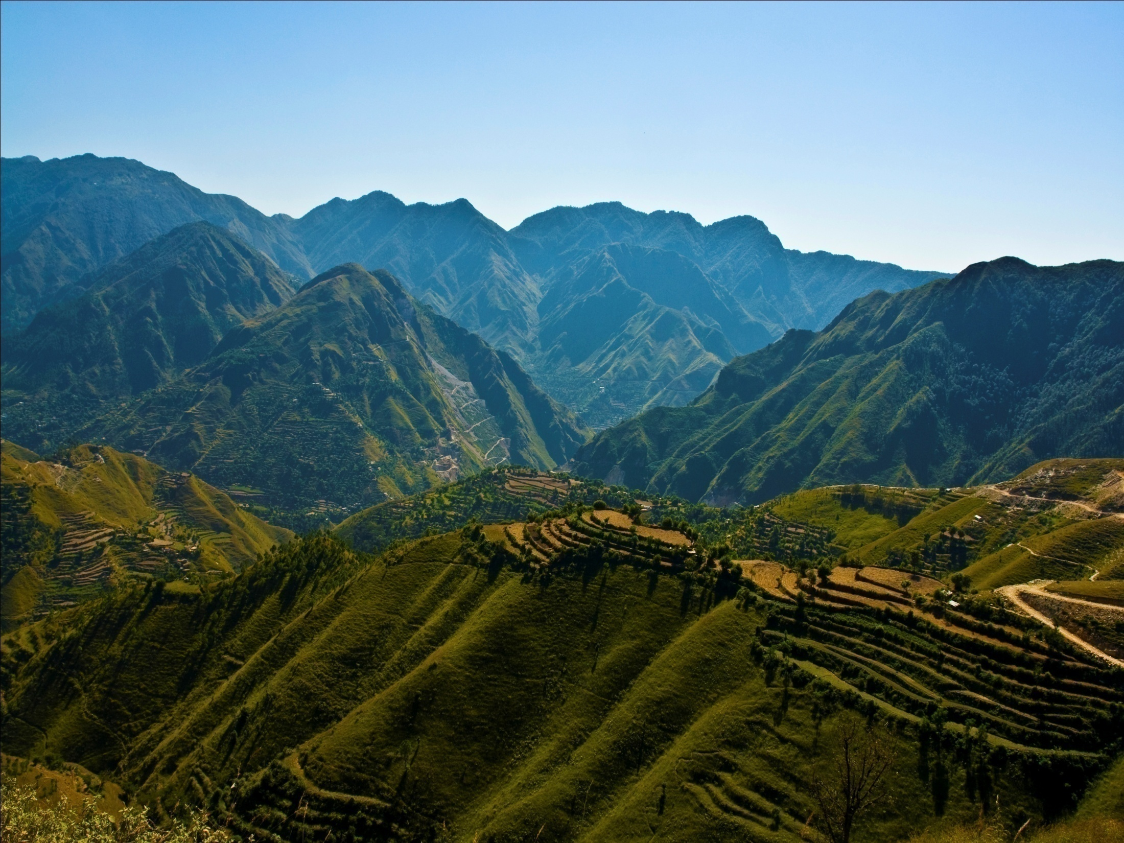
Thanks

