Slide 1

Regional Connectivity Scheme –
UDAN (RC-UDAN)
Regional Connectivity Scheme UDAN (RC-UDAN)
Civil Aviation Department, Haryana
07.07.2017
Civil Aviation Department, Haryana
07.07.2017

Slide 2
RCS-UDAN:
Advantage Haryana
  Multi model hinterland connectivity (road, rail, metro & other
  necessary infrastructure.
  Land free of cost excluding all encumbrances.
  Reduced VAT on Aviation Turbine Fuel to 1% or less, even for non-RCS operators.
  Free of cost security & fire services at RCS airports.
  Power and other utilities at substantially concessional rates.
  Viable gap funding to the airlines operators as applicable. State subsidy for remaining 50% seats.

Slide 3
Civil Aviation in Haryana-
Snapshot
5 civil airstrips
3 flying training centers by HICA
Pinjore
Hisar
Karnal
Pinjore
Hisar
Karnal
Narnaul
Crow-fly distance between New Delhi IGIA and Hisar Aerodrome
is approx.150 km.
.
Bhiwani

Slide 4
Hisar-Preferred RCS Destination
1
Existing
2
Steps Taken
  OLS, PCN and Friction Test conducted for the existing runway.
  Existing runway being expanded to 7000 ft. by March 2018.
  Necessary infrastructure for RCS airport including hangers & aprons for addl. parking and MRO under execution.
  Night landing facility, installation of navigational aids , ILS facilities and refuelling station. planned at Hisar and Karnal airports.
  Government owned land ~4,000 acres adjoining the Hisar airfield
  Airstrip (4000*150 feet)
  Hangars, terminal building and compound wall
  Operational Flying Club
  Fixed-based operations, aircraft parking facilities.

Slide 5
Integrated Aviation Hub
@ Hisar
Project Proposal
Action
Greenfield international airport and Aviation Hub planned.
Phased development of following activities planned:
  Domestic Airport
  Small scale MRO
  Defence Manufacturing and Defence MRO
  Aerospace Manufacturing
  Fixed base operations (FBO)
  Aviation Training Centre and Aviation University
  Aerotropolis-Commercial and Aerotropolis- Residential
Feasibility study conducted.
Existing Government land of 4200 acres adjoining existing airfield being transferred to CAD.
Site clearance for greenfield airport expected shortly.
EoI floated. Based on responses RFP being floated shortly for PPP project with liberal FAR and land use on SEZ pattern.
Rapid rail and expressway connectivity with Delhi planned.
Proposal for defence MRO and defence manufacturing facility under consideration.

Slide 6
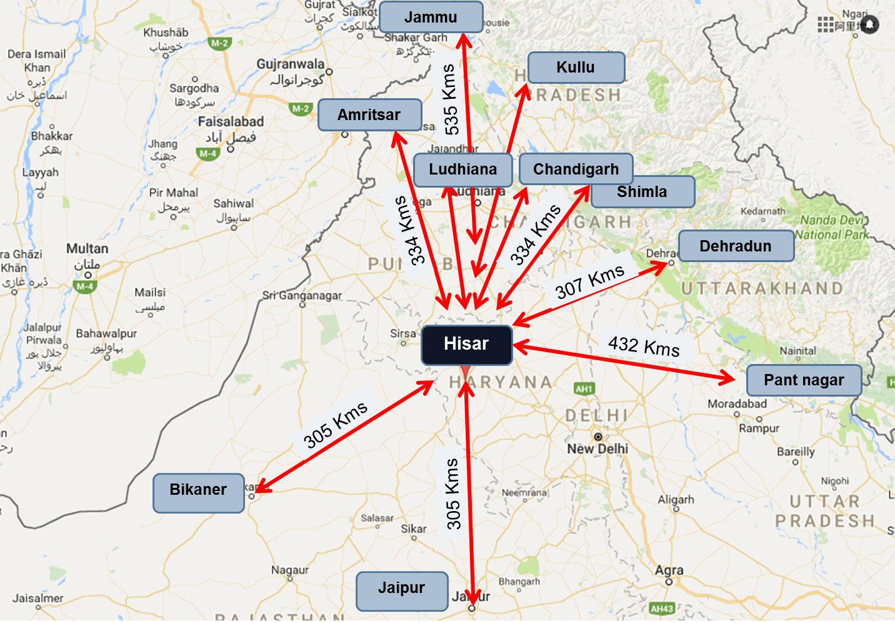
Hisar as an RCS* Hub
Source: Google Earth, Google Maps

Slide 7
Thank You

