Slide 1


INCredible
Chhatt sgarh
Aviation Department
(www.cgaviation.nic.in)
1

Slide 2

READINESS AND offers BY CHHATTISGARH
Among first 5 States to sign MoU on RCS With MoCA and subject Notification promulgated
Authorised Government officials permitted to travel by air within the state also
State is positive about additional seat
underwriting within the state and with adjoining states
State is positive about night parking facilities at state airports
Publicity support by the State Government is being progressed
We believe in “Bespoke Policy” where we customize incentives to make business viable
www.cgaviation.nic.in
2

Slide 3
ATTRACTIVE rcs airports OF CHHATTISGARH
AIR-STRIP | DIMEN -SION (Ft) | POPULA -TION/GDDP (In lakhs) | ECONOMIC DRIVERS | TOURIST HOT SPOTS
JAGDAL -PUR | 5575 X100 | 14.14/ 5,51,922 | NMDC, Essar, Bailadela Iron ore mines etc. | Chitrakote & Teerathgarh Falls, Kutumsar Caves, Kanger Valley & Indravati National Park,, Rajmahal, Balaji Temple, Danteshwari Mata Temple Bastar Dusserah etc.
AMBIKA -PUR | 5330 X100 | 51.00 (Incl. adjoining Distt.)/ 41,57,123 | SECL, BALCO, HINDALCO, NTPC, SECL, KSTPS etc | Pali, Chaiturgarh, Mahamaya Temple, Mainpat Tibetan Camps, Ramgarh, Dipadih, Tatapani, Kailash caves, Semarsot & Badalkhol Sanctuary etc.
RAI- GARH (Jindal) | 4000 X50 | 14.94/ 10,99,408 | Jindal Steel & Power, Sanilo Steel, Nalwa Steel, NTPC, Adani Enterprises etc. | Rock Paintings, Girivilas Palace, Ogna Ghati, Gomarda Sanctuary etc.
BILAS- PUR | 5290 x50 | 26.64 / 12,43,503 | South Eastern Coal Fields Ltd, Sirgitti Industrial Growth Centre etc. | Kannan Pendri Zoological Gardens, Tala, Lutara Sharif, Didineshwari/Pataleshwar Temple Malhar, Mahamaya Temple, Ratanpur

Slide 4
PROPOSED RCS ROUTES
Tentative inter/intra state routes under present RCS rules, with alternate destinations at desirable frequency are as suggested below –
RAIPUR – JAGDALPUR – HYDERABAD / KOCHI and Back
RAIPUR - JAGDALPUR -VISHAKHPATNAM / CHENNAI and Back
RAIPUR - JAGDALPUR – NAGPUR / BHOPAL and Back
RAIPUR – AMBIKAPUR- VARANASI/ LUCKNOW / RANCHI and Back
RAIPUR – BILASPUR / RAIGARH - VARANASI/ LUCKNOW / RANCHI and Back
RAIPUR – BILASPUR / RAIGARH - BHUBNESHWAR and Back
www.cgaviation.nic.in
4

Slide 5
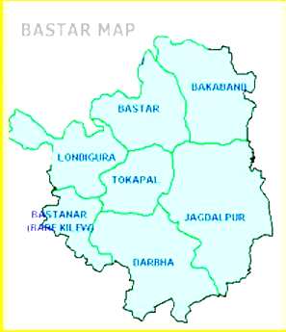
ATTRACTIVE rcs airports - Jagdalpur
Population (town)
Census-2011
1,14,345
Population (district)
Census-2011
14,13,199
Gross District Domestic Product (GDDP)
5,51,992 (Lakhs Rs. )
Major Industries
Sponge Iron, Iron Ore, Stone Crusher, Steel Fabrication, Steel Structure, etc.
Eminent Investors
NMDC Iron & Steel Plant, Essar Steel, etc. NMDC has country’s largest iron ore mine, Steel Plant of 3 mtpa is starting next year

Slide 6
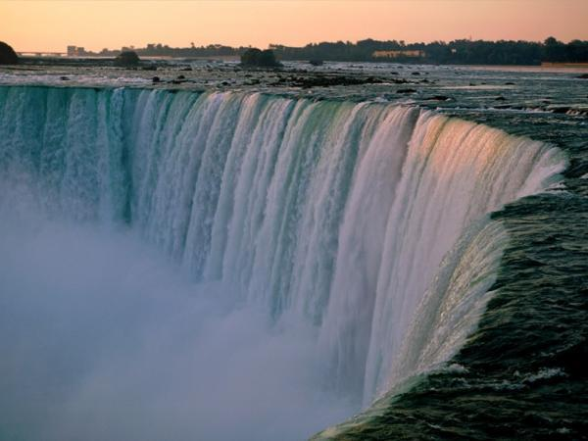
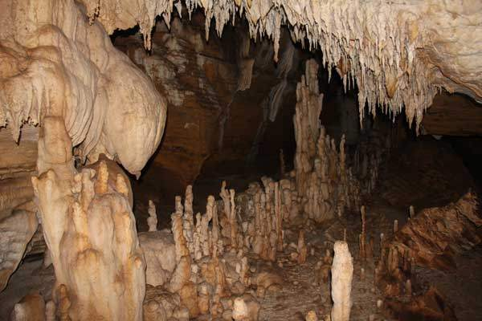
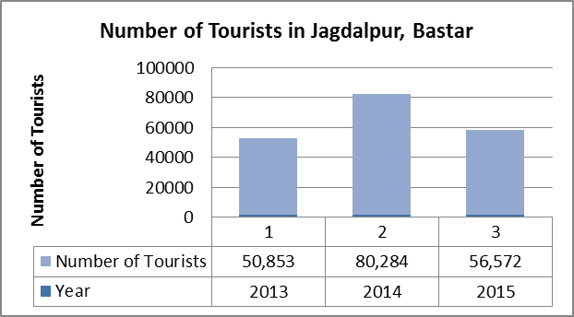
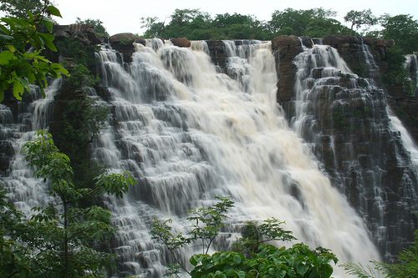
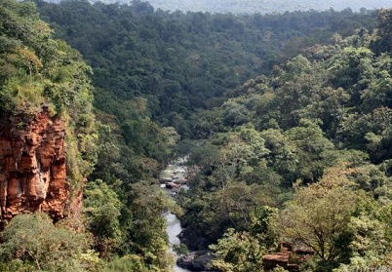
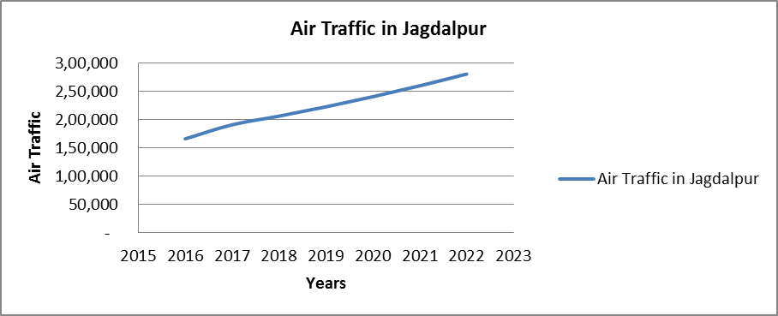
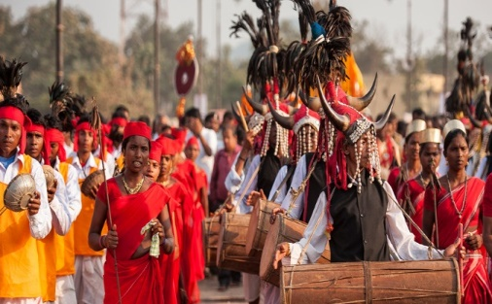
ATTRACTIVE rcs airports - Jagdalpur
Chitrakote Falls
Kutumsar Caves
Kanger Valley National Park
Teerathgarh Falls
Tourism Hot Spots
Bastar Dussehra Fest

Slide 7
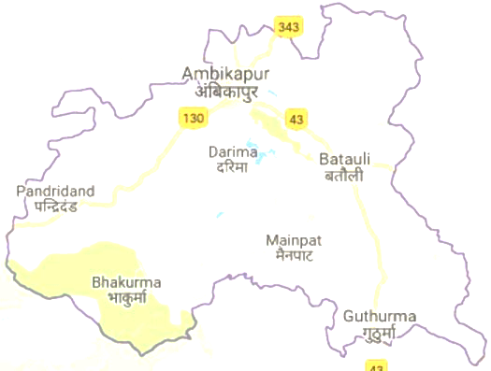
ATTRACTIVE rcs airports - Ambikapur
Population (town)
Census-2011
1,67,268
SARGUJA MAP
Population (district)
Census-2011
23,59,886
Gross District Domestic Product (GDDP)
7,57,123 (Lakh Rs)
Natural Resources
Bauxite, Coal, Mica Berylluiim, Byrites, Copper, Galena etc.
Eminent Investors
SECL, BALCO,
HINDALCO , etc.

Slide 8
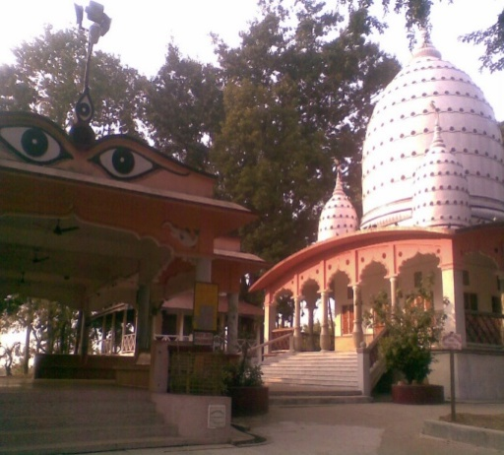
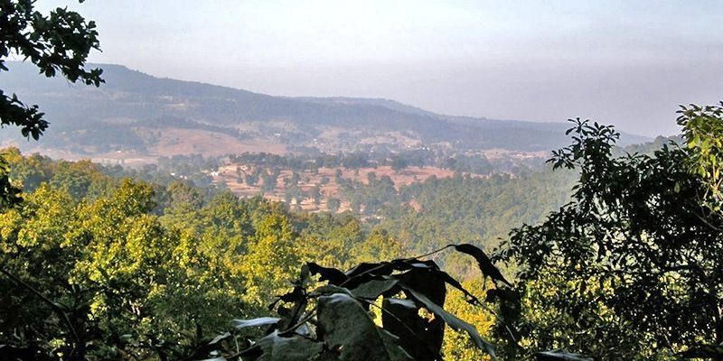
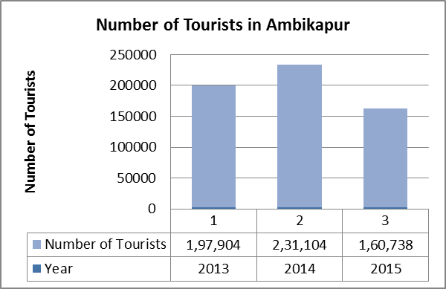
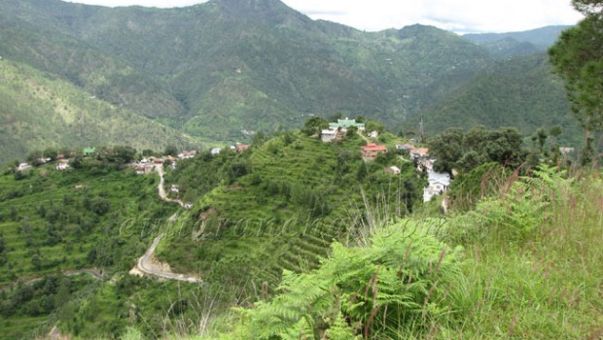
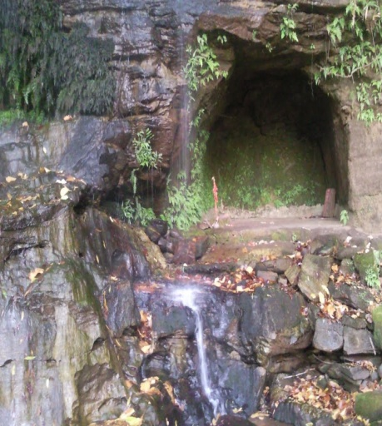
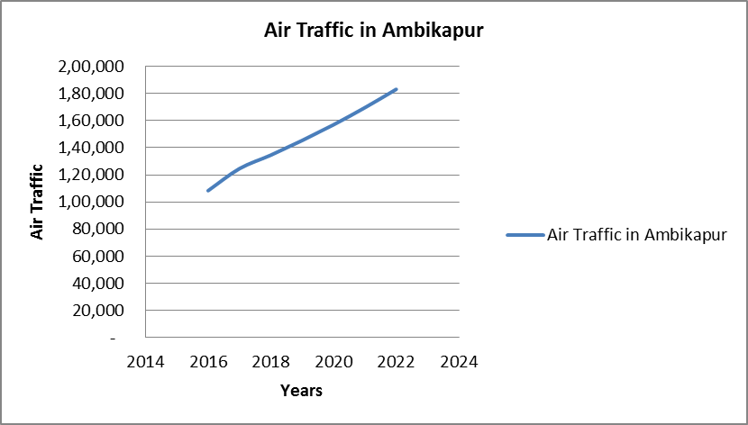
ATTRACTIVE rcs airports - AMBIKAPUR
Mahamaya Temple
Mainpat
Ramgarh
Kudargarh
Tourism Hot Spots

Slide 9
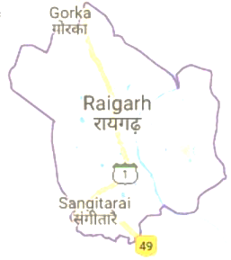
ATTRACTIVE rcs airports - raigarh
Population (town)
Census-2011
1,57,285
RAIGARH MAP
Population (district)
Census-2011
14,93,984
Gross District Domestic Product (GDDP)
10,99,408 (Lakhs Rs.)
Natural Resources
Coal, Quartzite, Limestone, Dolomite, etc.
Eminent Investors
Jindal Steel & Power, Singhal Enterprise, Sanilo Steel, Nawla Steel, etc.

Slide 10
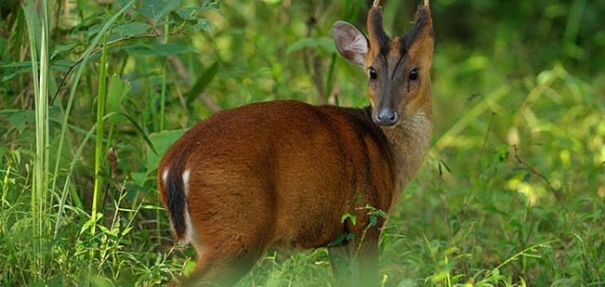
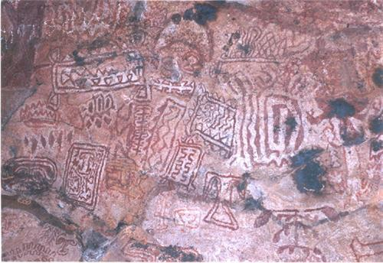
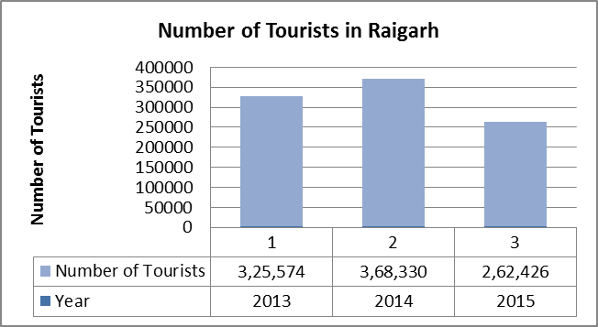
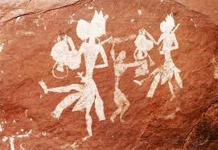
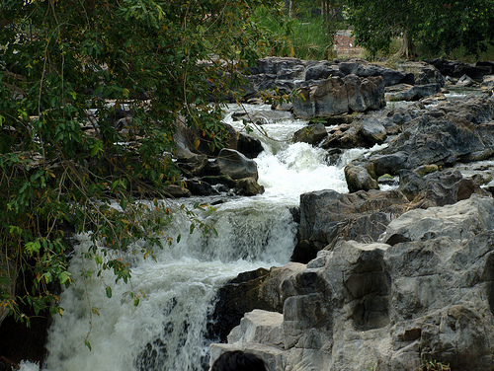
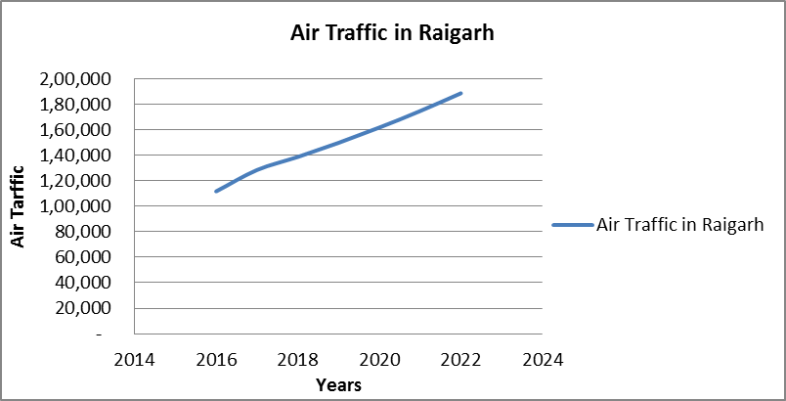
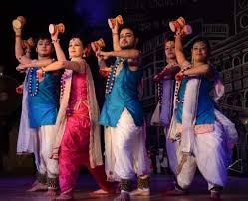
ATTRACTIVE rcs airports - raigarh
Rock Paintings, Kabara Pahad
Gomarda Sanctuary
Singhanpur Caves
Ram Jharna
Tourism Hot Spots
Raigarh Chakradhar Festival

