Slide 1
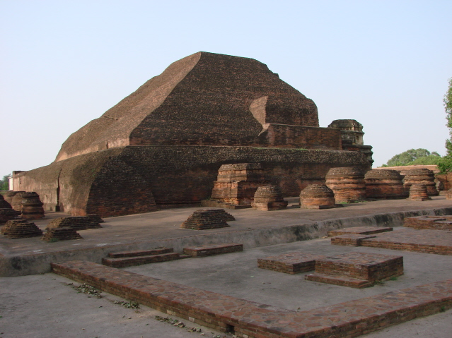

REGIONAL CONNECTIVITY PROPOSAL FOR HINTERLAND BIHAR
DIRECTORATE OF CIVIL AVIATION
CABINET SECRETARIAT DEPARTMENT
GOVT. OF BIHAR

Slide 2
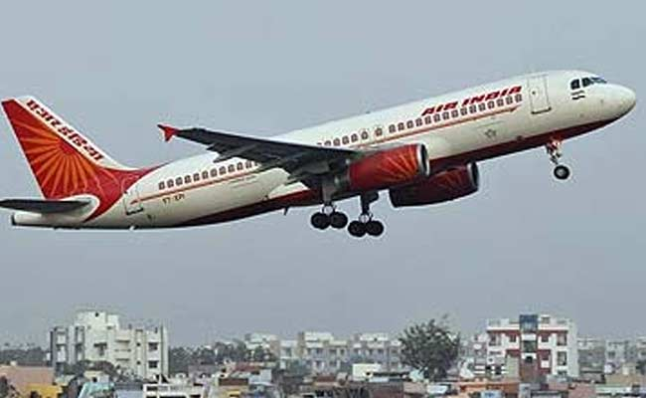

Government Of Bihar
1. VISION / OBJECTIVE
Affordable and time saving regional connectivity to people of Bihar for balanced regional growth.
Promote Tourism – Both Foreign and Domestic.
Connect Patna/Bihar to North East, Eastern states & UP .
2. GUIDING PRINCIPALS
Connect capital city Patna to different regional growth centers in Bihar.
Connect places of Buddhist Circuit and other Pilgrimages.
Promote Eco Tourism.
Connect Medical Hubs with hinterland.

Slide 3
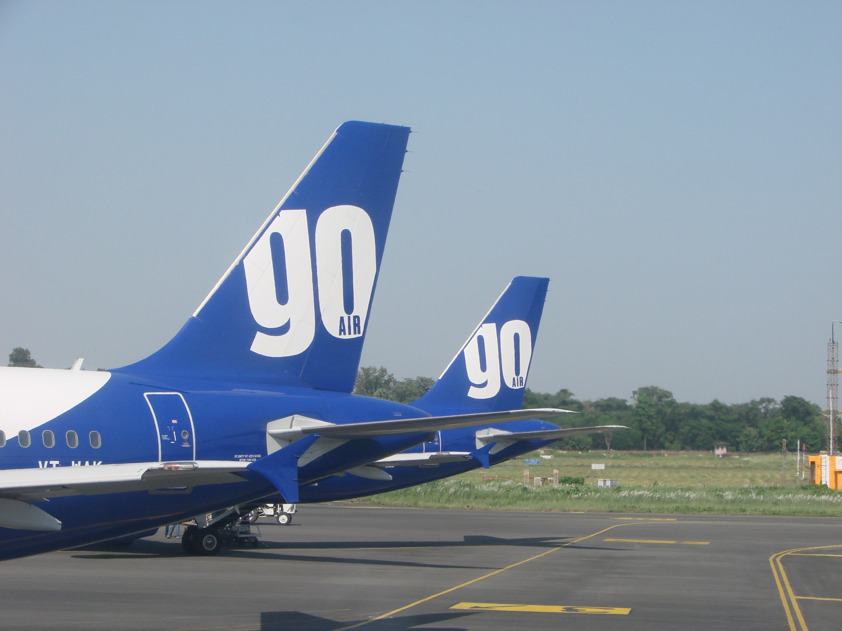
3. SUPPORT FROM BIHAR GOVT.
As in MoU to be signed in the next week in Patna
1. VAT @ 1% on ATF at RCS Airports located in the state for 10 years.
2. Minimum Land, if needed, free of cost for development of RCS Airports.
3. Free security and Fire services at RCS Airports.
4. Electricity, water and other utility services at concessional rates.
5. 20% contribution to RCS for VGF.
4. ADDITIONAL SUPPORT BY BIHAR GOVERNMENT
1. In Principal approval allowing officers above the Sixth Pay Commission Grade Pay Rs. 5400 to travel by air on RCS seats for official work within the state.
2. Free of cost Parking facilities in State Hangar in Patna Airport and all State
govt. RCS Airports.
Government Of Bihar

Slide 4
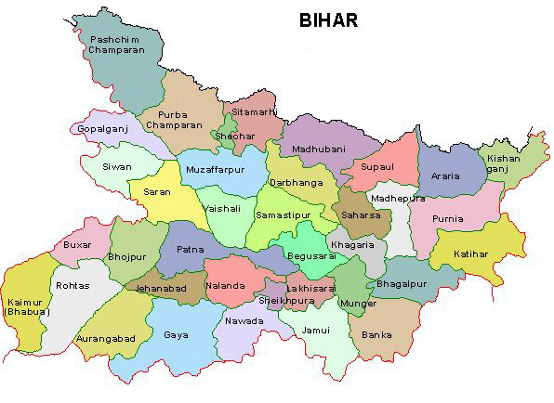
AAI Airports in Bihar
Government Of Bihar
Patna
Muzaffarpur
Raxaul
Gaya
Farbisganj

Slide 5
Airforce Operated Airports in Bihar
Government Of Bihar
Bihta
Darbhanga
Purnia

Slide 6
Airports with runway length 3000 to 4000ft
Government Of Bihar
Begusarai
Kishanganj
Saharsa
Bhagalpur
Valmiki Nagar
Birpur
Madhubani
Chhapra

Slide 7
Airports with runway length 2500 to 3000ft
Government Of Bihar
Buxar
Bhabhua
Ara
Bihar Sharif
Motihari
Bettiah
Purnea (Civil)
Katihar

Slide 8
5. Probable Viable Routes
Government Of Bihar
A. Aircrafts having seating capacity of 9-20 Passengers
Sr. No. | From | To | Attraction
1 | Patna | Bhagalpur | Silk Hub, Tourism (Vikramshila), Business activities, Religious Tourism (Sultanganj and Deoghar)
2 | Patna | Begusarai | Business Activities, Travel of Executives
3 | Patna | Balmikinagar | Eco-Tourism – Valmikinagar Tiger Project
4 | Patna | Kishanganj | Tourism (NE States), Connectivity to north east – Farthest Distt. from Patna
5 | Patna | Darbhanga | Medical, Education, Tourism (Madhubani Paintings)
6 | Patna | Purnia | Affordable Regional connectivity to hinterland and Gateway to NE
7 | Patna | Deoghar | Religious Tourism (Baidyanathdham and Deoghar)
8 | Patna- Muz-Bhagalpur- Deoghar |  | Affordable Regional connectivity, supporting religious pilgrimage to Baidyanathdham
9 | Patna-Gaya- Purnia- Darbhanga |  | Business activities, Tourism and affordable Regional connectivity

Slide 9
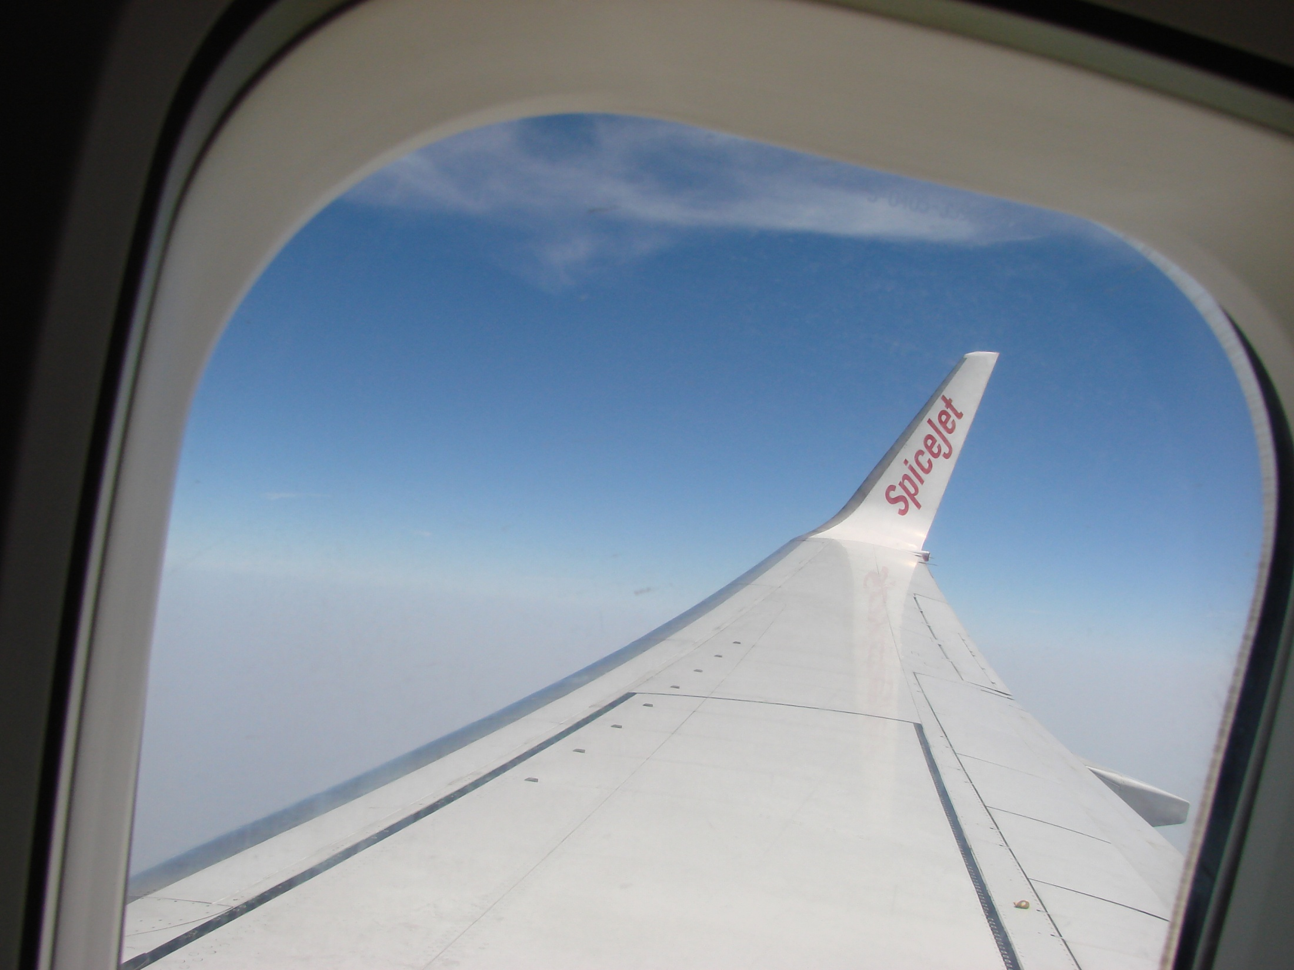
Government Of Bihar
B. Aircrafts having seating capacity of >40 Passengers – (To & Fro)
Sr. No. | From | Via | To | Attraction
1 | Patna | Purnia | Guwahati | North east connectivity, Medical Sector
2 | Patna | Darbhanga | Guwahati | Medical / NE connectivity
3 | Kolkata | Gaya- Varanasi- Kushinagar | Patna | Pind Daan, Tourism, Buddhist circuit, Foreign Tourist/SE Asian Tourists
4 | Patna | Darbhanga | Bagdogra | Connectivity hub and Gateway to NE
5 | Patna | Gorakhpur | Lucknow | Connecting hub
6 | Patna | Gaya | Deoghar | Pilgrimage and Tourism
7 | Patna | Gaya- Ranchi | Bhubaneswar | Connecting Hub
8 | Patna | Gaya | Kolkata | Tourism and Business Activities
9 | Patna | Purnia | Kolkata | Business / Economic Activities

Slide 10
Issues
Government Of Bihar
To Declare Gaya Airport as Underutilized airport under RCS.
The proposal has already been sent by RM, AAI, Kolkata to MoCA.
AAI requested to take up upgradation of its airports at Muzaffarpur, Raxaul and Forbisganj for RCS.
AAI to provide a temporary terminal building in the small piece of land provided in Purnia Airbase, Chunapur.
AAI is requested for rehabilitation and up gradation of state government airports as per clause 2.2.4 of RCS. The Capital and O&M cost will be borne by the State. This will facilitate for obtaining license from DGCA for schedule operations.

Slide 11
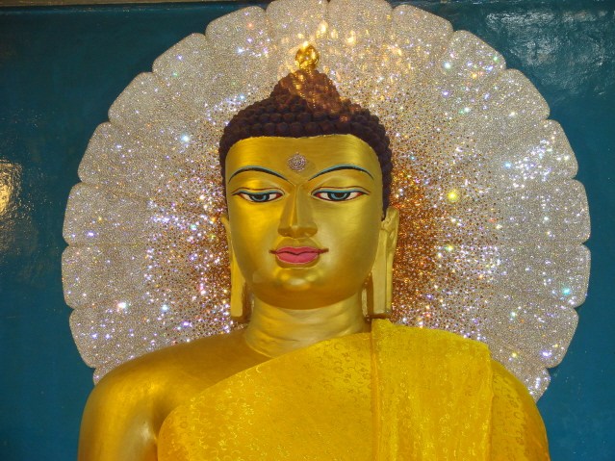
THANK YOU
धन्यवाद

