Slide 1
UDAAN : ADDITIONAL INCENTIVES IN ANDHRA PRADESH
WINGS: 7th July,2017

Slide 2
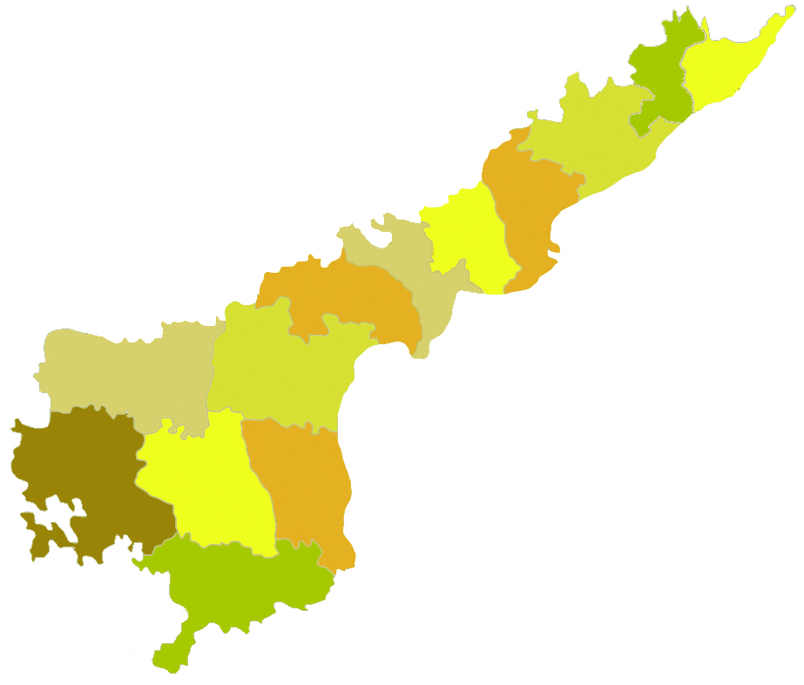

RCS flights in AP
RCS Flights status in A.P
RCS Airport in AP: Kadapa
Airlines for RCS flights in AP: Trujet and Air Odisha
Destinations to be served from Kadapa:
TruJet : i) From Jun 17: Hyderabad-Kadapa-Hyderabad (operational)
Kadapa-Bangalore-Kadapa (non-operational)
  ii) From Sept 17: Vijaywada-Kadapa-Chennai-Kadapa-Vijaywada
  Air Odisha: From Sept 17: Chennai-Kadapa-Bangalore-Kadapa-Chennai
From Vizag:
Air Odisha: From Sept 17: Jagdalpur (Chattisgarh)-Vizag-Jagdalpur

Slide 3
Incentives Available
Airlines
Underwriting specific number of airline seats or certain percentage of the capacity of the aircraft, as assessed by the government
Providing an airline seat subsidy for airlines operating to specified airports in the State on specified routes based on traffic levels through competitive bidding
Reduced VAT on Aviation Turbine Fuel (ATF).
  VAT on ATF in the State is 1%

Slide 4
Proposed Incentives
    A. Domestic Flight Operations IN Andhra Pradesh
    Landing, Parking & Over-Night Parking charges would be reimbursed for Scheduled Airline, Regional Airline and Scheduled Commuter Airline in respect of aircrafts with maximum certified capacity of more than 80 passengers seats.
    As per DGCA AIC no. 10/2016 “No landing charges shall be applicable in respect of Aircraft with a maximum certified capacity of less than 80 seats operated by domestic scheduled operators at non- major airports.”
  Route Navigation Landing Charges (RNLC) and Terminal Navigation Landing Charges (TNLC) shall be re- imburseable in respect of Aircraft with maximum certified capacity of less than 80 passenger’s seats operated by domestic scheduled operators at non- major airports.
  iii. Incentives at (i) and (ii) will only be available for first nine aircrafts, which are based at any of Andhra Pradesh Airports i.e: Vijayawada, Rajahmundry, Tirupati, Kadapa and Vishakhapatnam.
  iv. Landing, Parking charges at Vijayawada Airport shall be reimbursed to first flight of the first operating Airline on following sectors for direct non-stop flight on Vijayawada – Kolkata or Vijayawada – Mumbai sectors.

Slide 5
Proposed Incentives
  B. International Flight Operations in Andhra Pradesh:
    Reimbursement of landing and parking charges for International flights from Tirupati & Vijayawada International Airports.
Incentives will only be available for first three flights from each airport
NOTE:
    All incentives will be applicable only for flights with less than 80% average Monthly load factor.
    Valid for a period of 2 years from the date of adoption of the Policy.

Slide 6
Thank you

