Slide 1

Presentation by :
Capt. Ajay Chauhan,
Director of Civil Aviation, Govt. of Gujarat.

Slide 2
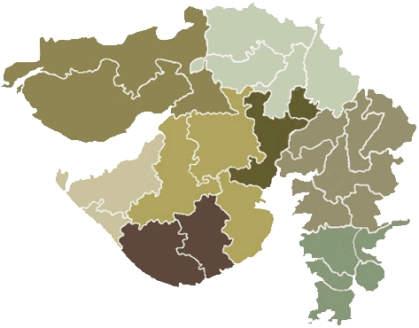
INFRASTRUCTURE IN STATE
Airports
Gujarat possesses one of the largest networks of airports and airfields in the country
The State of Gujarat has a total of 17 Airports of which 09 are under operational jurisdiction of the Airport Authority of India (AAI), 3 with I.A.F. of which 2 have Civil Terminal, 2 Airport are private Airports and 2 Airport are at union territory of Daman and Diu .
We have three Airstrips under the State Government jurisdiction
        Mehsana
        Amreli
        Mandvi
Out of the 09 AAI Airports Ahmedabad is an International Airport. The other are Vadodara, Surat, Jamnagar, Rajkot, Bhavnagar, Porbandar, Bhuj, Keshod, Kandla and Deesa which are Domestic Airport, Among these Keshod and Deesa Airport have no scheduled flight.
Deesa
Mehsana
Nalia
Bhuj
Mandvi
Kandla
Mundra
Ahmedabd
Jamnagar
Rajkot
Vadodara
Mithapur
Porbandar
Bhavnagar
Surat
Amreli
Keshod
Diu
Daman
Under AAI (09)
Ahmedabad
Vadodara
Rajkot
Bhavnagar
Deesa
Surat
Kandla
Porbandar
Keshod
Under IAF(03)
Nalia
Bhuj
Jamnagar
Private Air Ports(02)
Mithapur(Tata)
Mundra(Adani)
Union Territory(02)
Diu
Daman
Under State Govt.(03)
Amreli
Mehsana
Mandvi

Slide 3
AVIATION IN GUJARAT
Total Airport - 09 (AAI), 03 (IAF), 02(Private), 03(State Govt.)
Daily Dep. From Ahmedabad- 55 (Dom)+ 08(Intl)
Destination - 13 Cities (National), 09(International)
Planes Flying over Ahmedabad - 550
Every minute there is a plane flying over Ahmedabad.
Connectivity
Bhopal
Goa
Jaipur
Mumbai
Delhi
Guhati
Pune
Lucknow
Mumbai
Chennai
Ahmedabad
Domestic
Vadodara
Delhi
Hyderabad
Bagalore
Indore
Bangalore
Sri Nagar
Kolkata

Slide 4
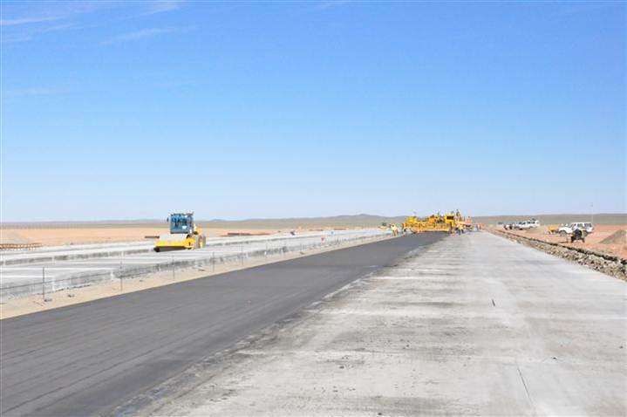
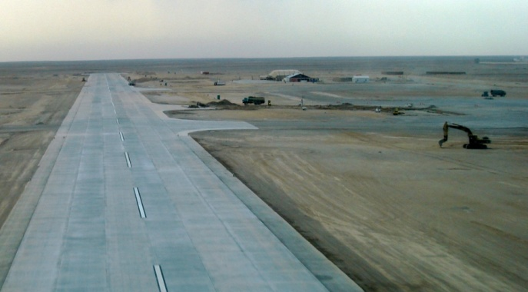
Department Obtain Approval for
CONSTRUCTION OF THE 9 AIRSTRIPS
The Government of Gujarat has decided to develop all the airstrips in the State, namely:
Ankleshwar Dist.Bharuch,
Palitana Dist. Bhavnagar,
Morbi Dist.Morbi,
Dwarka Dist.Devbhumi Dwarka,
Dahej Dist.Bharuch
Ambaji Dist.Banaskantha,
Dholavira Dist.Kutch-Bhuj,
Greenfield Airport at Rajkot
Bagodara Dist.Ahmedabad, (Aviation Park)
Of which in first stage the following four would be given priority Ankleshwar, Palitana, Dwarka and Ambaji.
Ambaji
Dholavira
Morbi
Bagodara
Dwarka
Rajkot
PalitaNa
Bharuch
Ankleshwar

Slide 5
Incentives under RCS
The Government Gujarat is actively working on providing incentives/ concessions as per signed MOU for the development of regional air connectivity scheme. The details are as under;
  Reduce VAT on ATF upto 1%
  Free Security and Fire Services
  Ambulance Services
  Water, Electricity and Other relevant amenities at concession rate
  Land free of cost if required
The additional add-ons is under consideration for attracting the private airlines to come in Gujarat. The details are as under;
  Additional VGF upto 10%
  Airport charges to be reimbursed on actual like: UDF, PSF, Housing charges

Slide 6
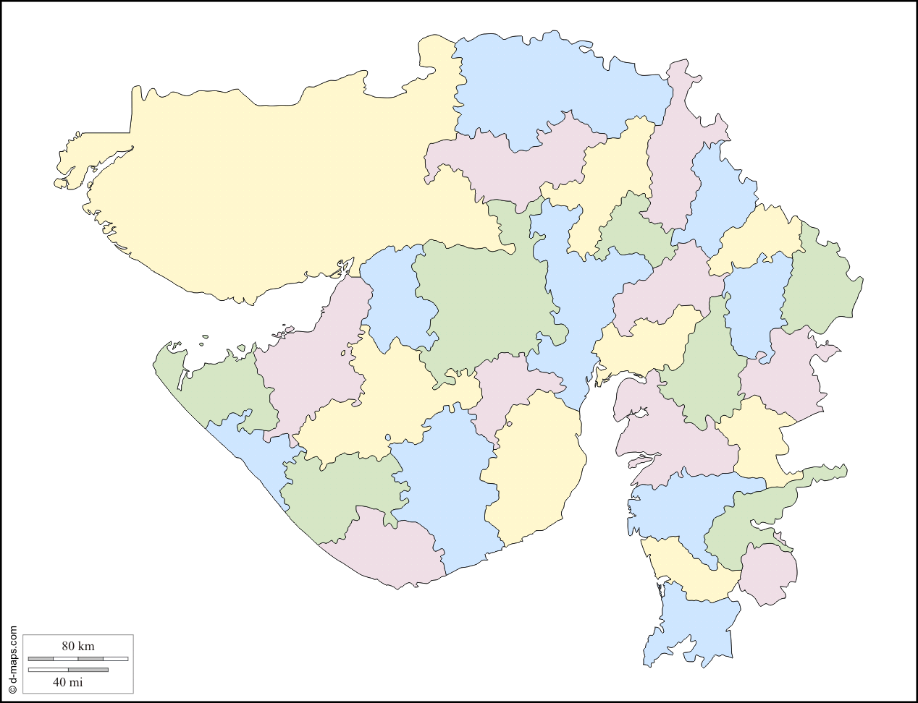
Under RCS following routs to be proposed
Deesa
Udaipur
Mandvi
Mehsana
Mandvi
Indore
Jamnagar
Vadodara
Rajkot
Mehsana ⇆ Surat
Deesa ⇆ Amreli
Vadodara ⇆ Mandvi
Rajkot ⇆ Porbandar
Mehsana ⇆ Jamnagar
Mehsana ⇆ Udaipur
Mehsana ⇆ Indore
Porbandar
Amreli
Mehsana – Surat
Deesa – Amreli
Vadodara – Mandvi
Rajkot – Porbandar
Mehsana – Jamnagar
Mehsana- Udaipur
Mehsana – Indore
Surat

Slide 7


THANK YOU
www.cad.gujarat.gov.in
7
www.gujsail.org

